Slide 1
White Mountain Regional Medical Center
Antimicrobial Stewardship Update
Sustaining Quality Improvement Efforts Two Years after IQIC
Larissa Ditmore, RN CIC
8-18-26
Notes:
Good afternoon,
My name is Josh Burton and I am the Director of Pharmacy here at White Mountain Regional Medical Center. It is my pleasure to speak with you this afternoon about our antibiotic stewardship program.

Slide 2
Agenda
Background
01
Data Collection
02
Data Findings
03
Interventions
Conclusion
04
Notes:
The Agenda for this session is that I would like to briefly talk about our background here at WMRMC. We will look at our data collection efforts. We’ll review the findings for our facility over since October 2022. What interventions we implemented during IQIC and after.

Slide 3
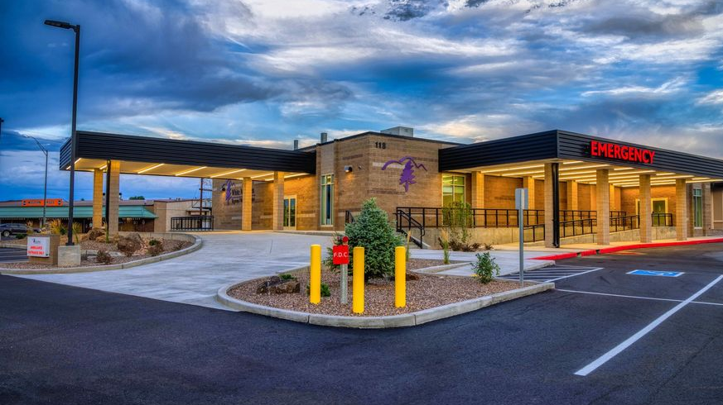
Background
Established Antibiotic Stewardship Program 2022
Antibiotic Stewardship Committee
Larissa Ditmore, R.N., BSN, Infection Control/Employee Health
Joshua Burton, PharmD, Director of Pharmacy
Notes:
White Mountain Regional Medical Center is a critical access hospital in NE Arizona. We have a 21 bed Med Surg, Swing Bed, Surgery and average about 7000 ER visits a year. When I left Med Surg to become the manager of Infection Prevention in 2022 there wasn’t an Antibiotic Stewardship Program. We found out about UW CSiM in the summer of 2022 and through our state rural health FLEX program were able to enroll. Our committee is just me and Josh. We collaborate with our chief of staff and chief hospitalist.

Slide 4
Data collection
ASB 201- May 2026: 448 Cases Submitted
ASB 101: 41 Cases Submitted
Notes:
Our CSiM journey began in October of 2022. At that point I really didn’t know what I was doing, I was learning infection prevention as well as this program.
That first year we submitted the minimum suggested monthly cases. Midway we received our first report and our physicians first comment was that our sample size was too small to be statistically significant. So for the second half I increased the sample size by submitting more cases. Received the same feedback.
At the midway of year 2 I started to submit all the cases. I was reviewing every single culture using the framework I had learned anyway so submitting the survey wasn’t much more work. And the conversation about significance was done.
After the 2 year IQIC project was done, we received funding again from the AZ FLEX funds to participate again. We had already completed the 2 year program, didn’t really have an idea for another quality project and still had issues with inappropriate diagnosis and treatment of UTI - so we continued to submit cases.

Slide 5
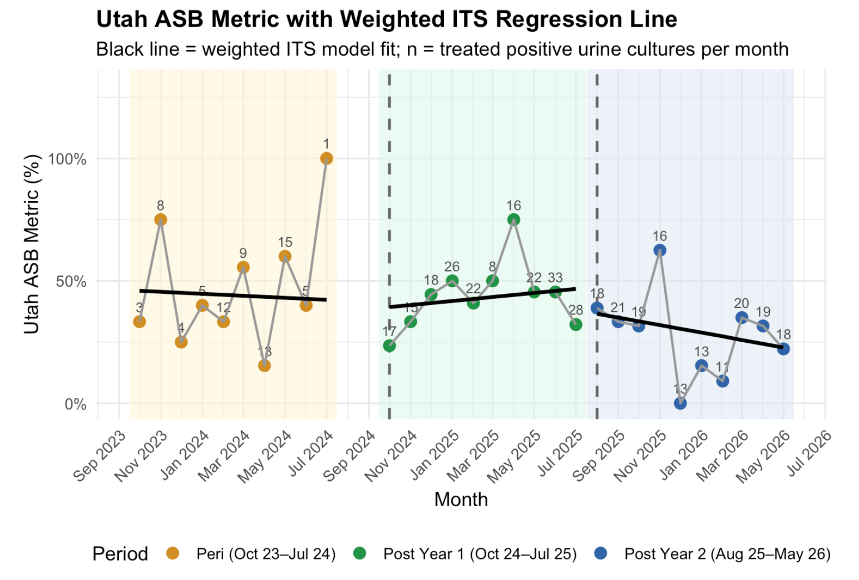
Outcomes:
Notes:
This is three graphs showing us the percent of treated ASB
Yellow is the 2nd year of IQIC
Green is First year post IQIC
Blue is 2nd year post IQIC
You can see that there is not much change between the last year of the IQIC project at 44% and the first year post IQIC at 43.4%.
But the second year post IQIC there is a significant decrease to 29.8%

Slide 6
Interventions
Notes:
Over the first 2 years we implemented a few things:
We educated our providers to the project… we discussed best practices, diagnostic stewardship, antibiotic durations
We educated patients and our community about appropriate use of antibiotics
Prospective audit and feedback
Being present as a resource to our ER and hospitalist providers
We used the reports to show how we were doing. During the second year we started reporting on each provider comparatively to their peers. (They are a competitive group as it turns out)
Last year I worked with our chief of staff on a standing order so in my work reviewing culture results I can discontinue antibiotics for ASB and change antibiotics if appropriate based on sensitivity within a strict framework.
Lastly we continued to collect data. Data is the thing that shows what is really going on. Our providers respond to the data as do our leadership
When we started this, most of our providers would tell you that they practice antibiotic stewardship, they already knew all about it because it’s part of their continuing education for their certification. But seeing the data and seeing their prescribing and treatment pattern in comparison to their peers… Maybe they aren’t doing as well as they though

Slide 7
Conclusion
Notes:
You know when there is a new quality project and we are (or aren’t) all in, and there’s all these new initiatives and excitement and stuff changes…. And then we think ok that’s taken care of and we move on?
I don’t think that this is one of those projects that goes away, it’s ongoing. I know in my hospital I have 2 old dog providers (you know what they say about old dogs and new tricks) In every status report they are the top 2 to order UA’s, one of them practically treats everyone. Being persistent I’ve seen changes over the past 4 years but then, suddenly old habits come back.
I have a theory though: We have 2 very busy seasons up here in the summer we are the playground for people who live in Phoenix and want to escape the brutal heat. In the winter (if the snow is good) we have some of the best skiing in the state. So when it gets really, really busy - like it’s been since July 4th- my old dogs go back to their old tricks.
But over all, continuing the project past two years and having the data reports has contributed to our improvement.

Slide 8

Conclusion
Any questions?

