Slide 1
TASP Toolkits:
Pneumonia
Theodore Wright, MD
January 2018

Slide 2
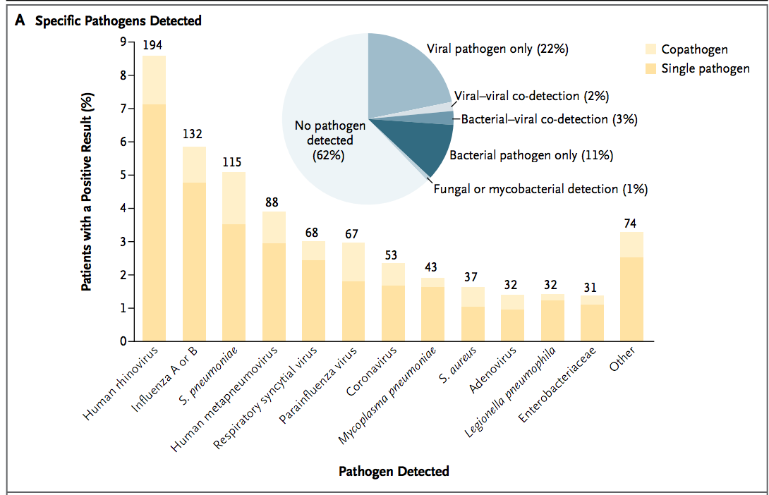
Pneumonia
Pulmonary parenchyma infected with viral, bacterial, or fungal pathogen.
Difficult to find the causative organism.
27% of cases are virus.
14% of cases are bacterial.
Common bacterial causes:
18-49yo;
Streptococcus pneumoniae > Mycoplasma pneumoniae > Staphylococcus aureus > Legionella pneumophila (atypical pathogen).
Jain, S.; et al. “Community Acquired Pneumonia Requiring Hospitalization among US Adults.” NEJM. 373:5. July 30,2015.

Slide 3
Is it CAP, HCAP, HAP, or VAP?
Patient factors:
Medical comorbidities and Setting can change causative organism.
Community-acquired pneumonia is caused by
Streptococcus pneumoniae.
Mycoplasma pneumoniae.
less likely: Staphylococcus aureus or Legionella.
HAP and VAP is caused by:
the same organisms as CAP.
PLUS risk for Pseudomonas aeruginosa and gram negative rods (E.coli) as well as multi-drug resistant organisms.

Slide 4
HCAP
Eliminated from updated IDSA/ATS guidelines.
Criteria for HCAP found to have alarmingly low sensitivity and specificity for infection from MDRO or pseudomonas.
Patient factors; such as functional status and medical comorbidities found to be as significant as where the infection was acquired.
http://www.idsociety.org/Guidelines/Patient_Care/IDSA_Practice_Guidelines/Infections_by_Organ_System/Lower/Upper_Respiratory/Hospital-Acquired_Pneumonia_(HAP)/

Slide 5
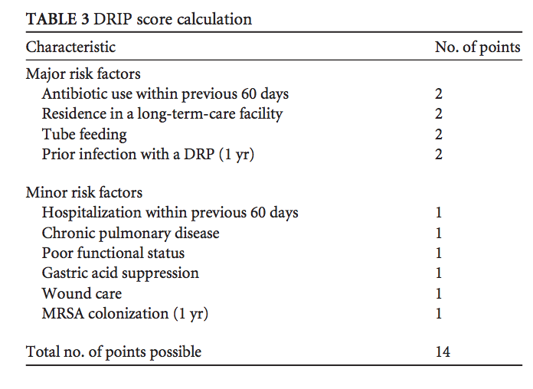
DRIP Score
HCAP criteria 69% accurate prediction of drug resistant pathogens, DRPs.
DRIP score of >= 4 is 81% accurate prediction of DRP
2 major critiera
1 major and 2 minor
4 minor criteria
Applying the DRIP score reduced use of broad spectrum antibiotics by 46%.
DRIP score of >= 4 is indication for broad antibiotic coverage to include Pseudomonas and possible MDROs.

Slide 6
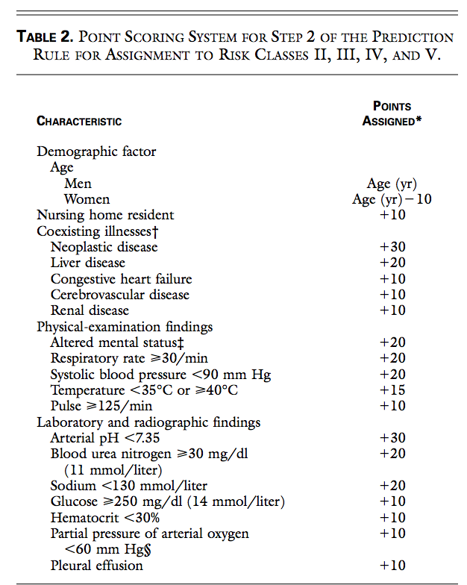
When to Admit
CURB-65 and PSI are equivalent scores.
PSI: No risk factors is class I, score <70 is class II, score 71-90 is class II, score of 91-130 is class IV, and >130 is class V. PSI class I = Outpatient management.
PSI Class II or III can be managed as an outpatient with home services.
PSI Class IV or V should be admitted to the hospital and consider whether they are appropriate for the ICU.

Slide 7
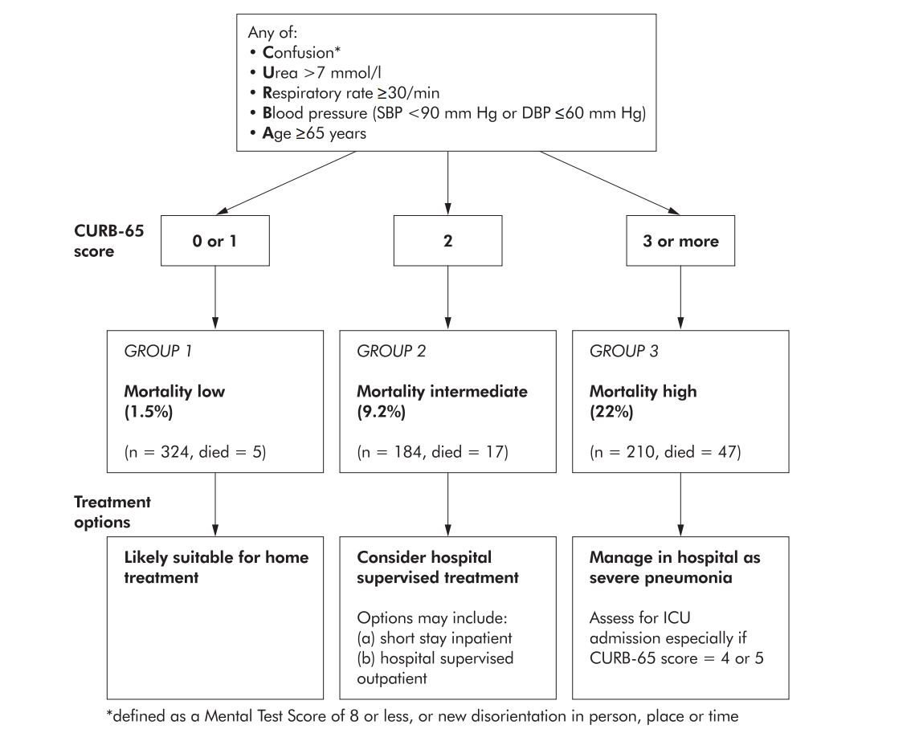
When to Admit
CURB-65 score of 0 can be managed as outpatients.
CURB-65 score of 1 or 2 should be admitted to the hospital.
CURB-65 score of 3-5 should be admitted and considered for intensive care.

Slide 8
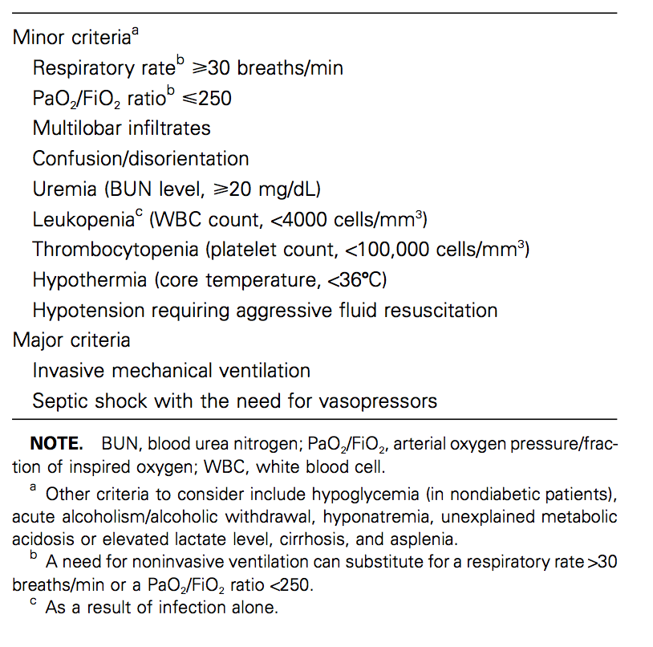
ICU or Floor?
IDSA Criteria for ICU treatment of CAP
1 Major criteria or 3 minor criteria

Slide 9
Diagnosis of CAP, HAP, VAP
History, radiology, and labs useful in diagnosis of pneumonia.
HAP and VAP should be diagnosed with non-invasive techniques; i.e. no bronchoscopy, but rather expectorated sputum.

Slide 10
Risk for drug resistant S.pneumoniae
Incidence of drug resistant strep pneumoniae, DRSP, is highly variable and changing. In 2000 it was estimated that nationally 20% of streptococcus pneumoniae isolates were PCN resistant.
Risks factors:
chronic heart disease,
chronic lung disease,
liver disease, or renal disease; diabetes mellitus, alcoholism, malignancy, asplenia, immunosuppression, or use of antimicrobials within the previous 3 months

Slide 11
Treatment of CAP
Outpatient treatment of a patient without risk factors for DRSP
azithromycin 500 mg po x 1 then 250 mg po daily x 4 days
Or doxycycline 100 mg po BID x 5 days.
Concern for drug resistant streptococcus pneumoniae (DRSP):
levofloxacin 750 mg PO daily or
Amoxicillin 1000 mg PO TID plus azithromycin 500 mg PO x 1 dose then 250 mg PO daily x 4 days.

Slide 12
Tx of CAP
Inpatient treatment:
Ceftriaxone 1 gm IV daily x 5 days
plus azithromycin 500 mg PO/IV x 1 dose then 250 mg PO/IV daily x 4 days.
Alternative: levofloxacin 750 mg PO/IV daily x 5 days.
IV is not required for inpatient treatment. If there is no concern for resistant organisms the treatment does not require broader or parenteral antibiotics.

Slide 13
Switching to orals for CAP on DC
Switch to orals after 48-72 hours of no fever and no more than 1 sign of clinical instability.
Signs of clinical instability include:
T >37.8C,
HR >100 bpm,
RR >24,
SBP <90 mmHg,
SaO2 < 90% or pO2 < 60 mmHg on room air,
inability to maintain oral intake,
abnormal mental status.

Slide 14
Switching to orals for CAP on DC
No risk for DRSP:
Change to Amoxicillin 500 mg po TID or 875 mg PO BID. If the patient has already received 1.5 gm of azithromycin this can be discontinued. Other options are azithromycin 500 mg po daily, clarithromycin 500 mg po BID, or doxycycline 100 mg po BID.
RF for DRSP:
Change to Amoxicillin 1 gm PO TID.

Slide 15
Dx of HAP and VAP
Hospital Acquired Pneumonia, HAP:
Develops more than 48 hours after admission and no evidence of pneumonia on admission.
Ventilator Associated Pneumonia, VAP:
HAP that develops 48-72 hours after intubation and no evidence of pneumonia at time of intubation.
The diagnosis of HAP and VAP should be made from non-invasive diagnostic methods.
Expectorated sputum or ETT aspirate, not bronchoscopy.

Slide 16
Assess Risk Factors
MRSA risk:
Prior IV abx in the last 90 days.
Hospital MRSA rates >20%.
MRSA colonization
High mortality risk:
Need for ventilatory support
Shock

Slide 17
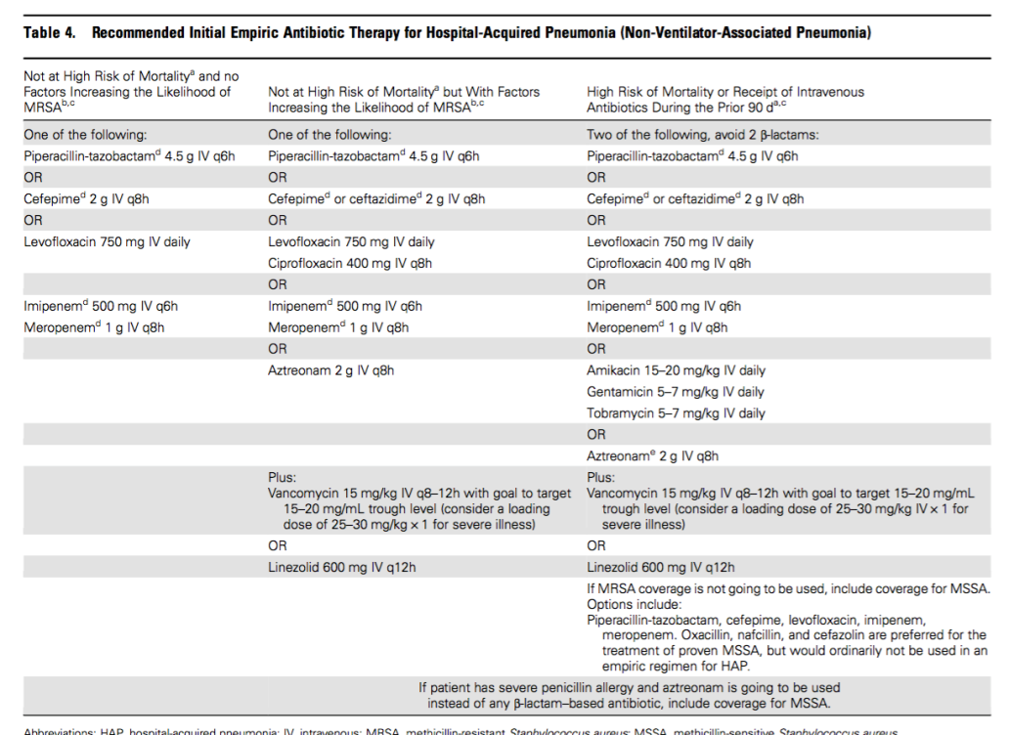
Treatment of HAP
No RF for MRSA & prevalence in the hospital < 10-20% then:
Cefepime 2 gm IV Q8H – Preferred
Piperacillin-tazobactam 4.5 gm IV Q6H.
Levofloxacin 750 mg IV/PO daily.
Meropenem 1 gm IV Q8H
RF for MRSA or hospital prevalence > 10-20% then add MRSA coverage with:
Vancomycin 25-50 mg/kg IV x 1 followed by 15 mg/kg IV Q8H-Q12H mg/kg IV with goal trough 10-20
Linezolid 600 mg IV/PO Q12H

Slide 18
Treatment of HAP with risk for MDRO
High risk of mortality & received IV abx in the last 90 days then prescribe 2 of the following; avoiding two from the same class:
Cefepime 2 gm IV Q8H
Ceftazidime 2 gm IV Q8H
Piperacillin-Tazobactam 4.5gm IV Q6H
Levofloxacin 750 mg po/IV daily
Cipro 400 mg IV/PO daily
Gentamicin 5-7 ,mg/kg IV Qday
Aztreonam 2 gm IV Q8H
This provides double coverage for pseudomonas in the setting of high risk of mortality.

Slide 19
Treatment of VAP
No RF for MRSA & hospital has < 10-20% prevalence of MRSA:
Cefepime 2 gm IV Q8H-Preferred
Piperacillin-Tazobactam 4.5 gm IV Q6H
Ceftazidime 2 gm IV Q8H
Meropenem 1 gm IV Q8H
Aztreonam 2 gm IV Q8H
RF for MRSA or known colonization with MRSA or hospital MRSA prevalence >10-20% also add one of the following:
Vancomycin 25-30 mg/kg loading dose followed by 15-20mg/kg IV Q8H to Q12H - Preferred.
Linezolid 600 mg IV Q12H.

Slide 20
Treatment of VAP with Risk for resistant Pseudomonas aeruginosa
Awaiting culture results for a critically ill patient or your patient has known Pseudomonas aeruginosa and fails to improve on a single agent that is known to be susceptible to then consider adding a second agent from the following classes without using two antibiotics from the same class:
Ciprofloxacin 400 mg IV Q8H
Levofloxacin 750 mg IV Qday
Gentamicin 5-7 mg/kg IV Q24H

Slide 21
Switch to Oral and DC for HAP/VAP
This change should be based on available culture data and clinical improvement.
Total duration of antibiotics for HAP and VAP should be 7 days if the patient has improved and has no evidence of persisting infection after 7 days.

Slide 22
De-escalate!
If no staphylococcus aureus or GNR is isolated from adequate sputum sample and the patient is improving then it is okay to narrow antibiotic coverage appropriately.
If MRSA nares swab is negative then okay to discontinue MRSA coverage.

Slide 23
Orderset Examples
Patient meets admission criteria for community acquired pneumonia, CAP, and does not require intensive care unit:
Ceftriaxone 1 gm IV Q24H plus Azithromycin 500 mg IV/PO Q24H.
If PCN allergic:
Levofloxacin 750 mg po/IV day.
De-escalating to oral abx for CAP:
No RF for drug resistant streptococcus pneumoniae – Pick one of the following
Amoxicillin 500 mg po TID or 875 mg po BID.
Doxycycline 100 mg po BID
Okay to stop azithromycin if the patient has received 1.5 gm.
If RF for drug resistant streptococcus pneumoniae (age >65 yo; beta-lactam, macrolide, of fluoroquinolone therapy within the past three to six months, alcoholism, medical comorbidities, immunosuppressive therapy, or exposure to a child in a daycare center) – Please use the following
Amoxicillin 1gm PO TID
If PCN allergic:
Levofloxacin 750 mg po daily

Slide 24
Orderset Examples
Patient develops pneumonia >48 hours after admission to the hospital and no signs or symptoms of pneumonia were present on admission.
Patient has no RF for MRSA and no known MRSA colonization and you hospital has < 10-20% prevalence of MRSA. Choose one of the following:
Cefepime 2 gm IV Q8H – Preferred
Piperacillin-tazobactam 4.5 gm IV Q6H.
Levofloxacin 750 mg IV/PO daily.
Meropenem 1 gm IV Q8H
Patient has RF for MRSA or known MRSA colonization or your hospital has > 10-20% prevalence of MRSA.
One of the following:
Vancomycin 25-50 mg/kg IV x 1 followed by 15 mg/kg IV Q8H-Q12H mg/kg IV with goal trough 10-20
Linezolid 600 mg IV/PO Q12H
Plus one of the following
Cefepime 2 gm IV Q8H – Preferred
Piperacillin-tazobactam 4.5 gm IV Q6H
Levofloxacin 750 mg IV/PO daily
Meropenem 1 gm IV Q8H
If the patient has a high risk of mortality and received IV abx in the last 90 days then please prescribe 2 of the following; avoiding two from the same class:
Cefepime 2 gm IV Q8H
Ceftazidime 2 gm IV Q8H
Piperacillin-Tazobactam 4.5gm IV Q6H
Levofloxacin 750 mg po/IV daily
Cipro 400 mg IV/PO daily
Gentamicin 5-7 ,mg/kg IV Qday
Aztreonam 2 gm IV Q8H

Slide 25
Orderset Examples
Patient develops pneumonia 48-72 hours after intubation – Empiric therapy should cover MSSA, GNR, and Pseudomonas Aeruginosa:
If no RF for MRSA and your hospital has < 10-20% prevalence of MRSA then please start one of the following:
Cefepime 2 gm IV Q8H – Preferred
Piperacillin-Tazobactam 4.5 gm IV Q6H
Ceftazidime 2 gm IV Q8H
Meropenem 1 gm IV Q8H
Aztreonam 2 gm IV Q8H
If your patient has RF for MRSA or known colonization with MRSA or your hospital has a MRSA prevalence >10-20% then please also add one of the following:
Vancomycin 25-30 mg/kg loading dose followed by 15-20 mg/kg IV Q8H to Q12H - Preferred.
Linezolid 600 mg IV Q12H.
If you are awaiting culture results for a critically ill patient or your patient has known Pseudomonas Aeruginosa and is failing to improve on a single agent that is known to be susceptible to then consider adding a second agent from the following classes without using two antibiotics from the same class:
Ciprofloxacin 400 mg IV Q8H
Levofloxacin 750 mg IV Qday
Gentamicin 5-7 mg/kg IV Q24H

Slide 26
References
Jain, S.; et al. “Community Acquired Pneumonia Requiring Hospitalization among US Adults.” NEJM. 373:5. July 30,2015.
Chalmers, JD; Rother, Catriona; Salih, W; Ewig, S. “Healthcare-Associated Pneumonia Does Not Accurately Identify Potentially Resistant Organisms: A Systematic Review and Meta-Analaysis.” CID. 2014:58.
Lim, WS; et al. “Defining Community Acquired Pneumonia Severity on Presentation to Hospital: An International Derivation and Validation Study.” Thorax. 2003. Vol 58.
Fine, MJ; et al. “A Prediction Rule To Identify Low Risk Patients with Community Acquired Pneumonia.” NEJM. 1999. 336(4).
Chalmers, JD; et al. “Severity Assessment Tools for Predicting Mortality in Hospitalized Patients with Community-Acquired Pneumonia. Systematic Review and Meta-Analysis.” Thorax. 2010. Vol 65.
Mandell, LA; et al. “IDSA/ATS Consensus Guidelines on the Management of Community-Acquired Pneumonia in Adults.” CID. 2007. Vol 44.
Kalil, A.C.; Et Al. “Management of Adults with Hospital-Acquired and Ventilator-Associated Pneumonia: 2016 Clinical Practice Guidelines by the Infectious Diseases Society of America and the American Thoracic Society.” CID. 2016. Vol 63.
Webb BJ, et al. Antimicrob Agents Chemother. 2016 Apr 22;60(5):2652-63
Increasing prevalence of multidrug-resistant Streptococcus pneumoniae in the United States.AUWhitney CG, Farley MM, Hadler J, Harrison LH, Lexau C, Reingold A, Lefkowitz L, Cieslak PR, Cetron M, Zell ER, Jorgensen JH, Schuchat A, Active Bacterial Core Surveillance Program of the Emerging Infections Program Network SON Engl J Med. 2000;343(26):1917.

