Slide 1
Prophylactic Antibiotics Questions
Case selection
Which procedures benefit?
Choice of agents
Which antibiotics should you use?
Timing
When should you start?
Dosing
How much should you give? Intra-op redosing?
Duration
How long should antibiotics be continued?

Slide 3
Guidelines
“Surgical antibiotic prophylaxis administration
should not be prolonged after completion of
the operation.”

Slide 4
Less is MORE
2013 IDSA/ASHP/SIS/SHEA Recommendation
Duration should not exceed 24 hours
Risk of CDI 3x higher among patients who received post-op antibiotic prophylaxis beyond 24h (Bernatz et al, ICHE 2017)
Dose-dependent risk of CDI and AKI (Branch-Elliman et al. JAMA Surgery 2017)

Slide 5
Extended antimicrobial prophylaxis did not result in SSI reduction
Duration-dependent increased risk of AKI and CDI beyond 24h of antimicrobial prophylaxis

Slide 6
Timing of Prophylactic Antibiotic Administration for Total Hip Arthroplasty
van Kasteren. Clin Infect Dis 2007; 44:921

Slide 7
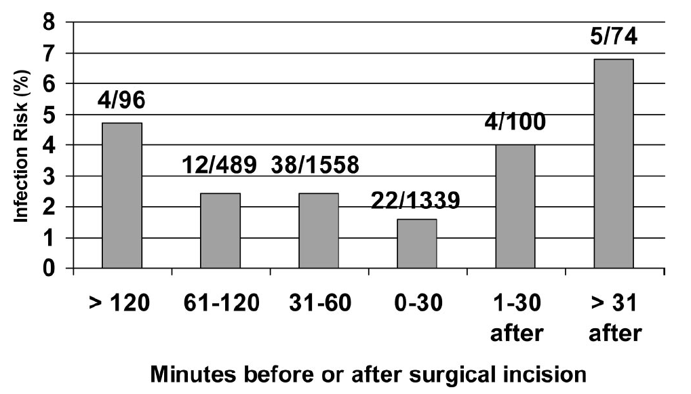
Timing of Prophylactic Antibiotic Administration – Cardiac, Arthroplasty, Hysterectomy
Steinberg. TRAPE. Ann Surg 2009; 250:10

