Slide 1
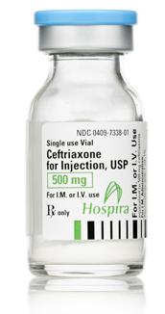
Antibiotics in Action (Hint: the answer is almost always ceftriaxone…)
Alyssa Castillo, MD
Division of Infectious Diseases
University of Washington

Slide 2
Disclosures
No financial disclosures
Specifically: No financial relationship with the manufacturers of ceftriaxone!

Slide 3
Learning Objectives
To give you tools to strategically select antibiotics for the “BIG 3” infections: pneumonia, UTI, and cellulitis
To “flip the narrative” – and focus on the most frequently utilized antibiotics and their spectrum (rather than review them all)
Today we will NOT discuss:
Antibiotic mechanism of action
Drug dosing
Duration of therapy

Slide 4
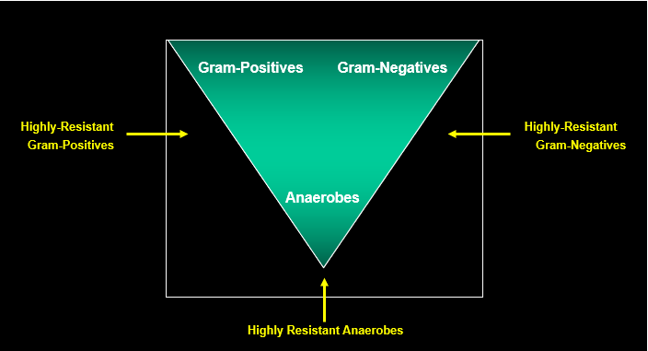
Slide credit: Drs David Spach and Paul Pottinger

Slide 5
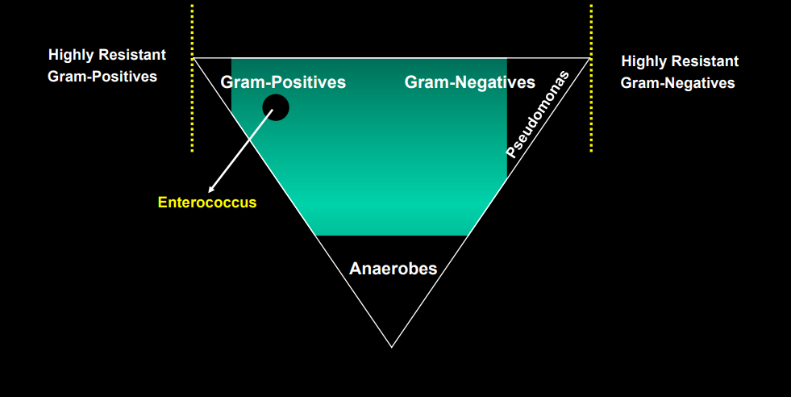
Ceftriaxone
Slide credit: Drs David Spach and Paul Pottinger

Slide 6
Case 1: Pneumonia

Slide 7
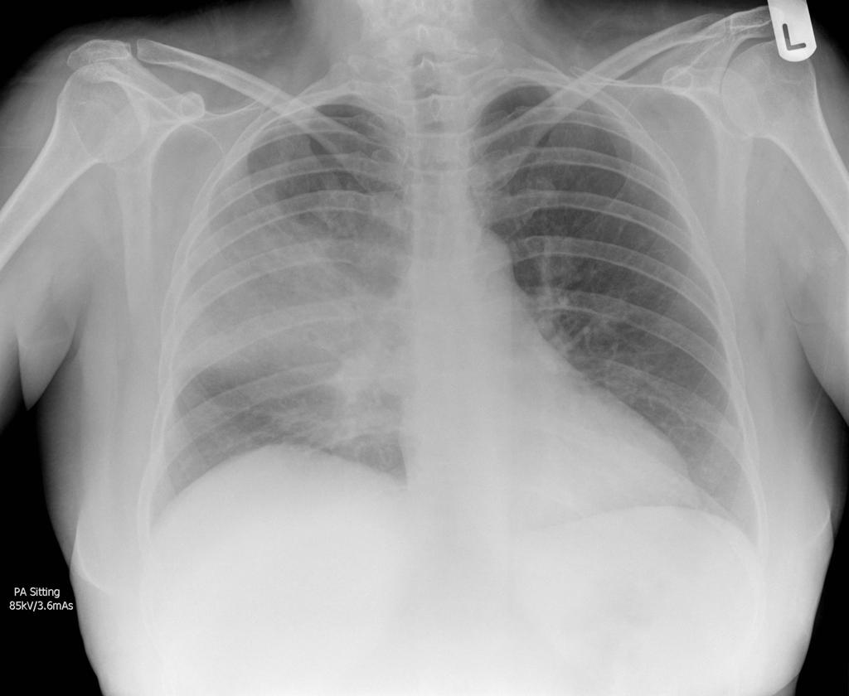
Case 1: Pneumonia
A 55-year-old patient presents to the ED with fevers, chills, cough, and purulent sputum.
A chest XR shows a lobar consolidation.

Slide 8
Case 1: Pneumonia
Audience Response Question
You start IV ceftriaxone + which additional antibiotic?
Vancomycin
Azithromycin
Trimethoprim-sulfamethoxazole (Bactrim)
A 55-year-old patient presents to the ED with fevers, chills, cough, and purulent sputum.
A chest XR shows a lobar consolidation.
They are diagnosed with community-acquired pneumonia, and admission is planned.

Slide 9
Case 1: Pneumonia
Audience Response Question
You start IV ceftriaxone + which additional antibiotic?
Vancomycin
Azithromycin
Trimethoprim-sulfamethoxazole (Bactrim)
A 55-year-old patient presents to the ED with fevers, chills, cough, and purulent sputum.
A chest XR shows a lobar consolidation.
They are diagnosed with community-acquired pneumonia, and admission is planned.

Slide 10
Ceftriaxone
Good strep !
Covers relevant GNRs:
-H influenzae
-M catarrhalis
Slide credit: Drs David Spach and Paul Pottinger

Slide 11
Azithromycin
In pneumonia:
Cornerstone of therapy for “atypical organisms”
Mycoplasma pneumoniae
Legionella pneumophila
Chlamydophila pneumoniae
Active against some Strep pneumoniae
Active against many Gram(+) and Gram(-) organisms
HOWEVER, use is limited because resistance is on the rise

Slide 12
Case 1: Pneumonia
For Community-Acquired Pneumonia (CAP), use ceftriaxone + azithromycin.

Slide 13
Case 1b: Pneumonia
Audience Response Question
What antibiotic would you recommend?
Azithromycin
Amoxicillin-clavulanate (Augmentin) + azithromycin
Trimethoprim-sulfamethoxazole (Bactrim)
Cephalexin
A 55-year-old patient with COPD presents to their primary care physician with fevers, chills, cough, and purulent sputum.
A chest XR shows a lobar consolidation.
They are diagnosed with community-acquired pneumonia. Outpatient treatment is planned.

Slide 14
Case 1b: Pneumonia
Audience Response Question
What antibiotic would you recommend?
Azithromycin
Amoxicillin-clavulanate (Augmentin) + azithromycin
Trimethoprim-sulfamethoxazole (Bactrim)
Cephalexin
A 55-year-old patient with COPD presents to their primary care physician with fevers, chills, cough, and purulent sputum.
A chest XR shows a lobar consolidation.
They are diagnosed with community-acquired pneumonia. Outpatient treatment is planned.

Slide 15
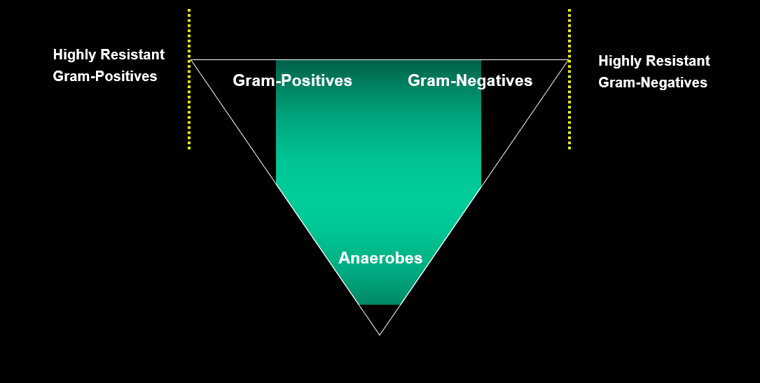
Amoxicillin-clavulanate (i.e. Augmentin)
Good strep !
Covers relevant GNRs:
-H influenzae
-M catarrhalis
Also covers anaerobes – a good choice if high suspicion for aspiration
Slide credit: Drs David Spach and Paul Pottinger

Slide 16
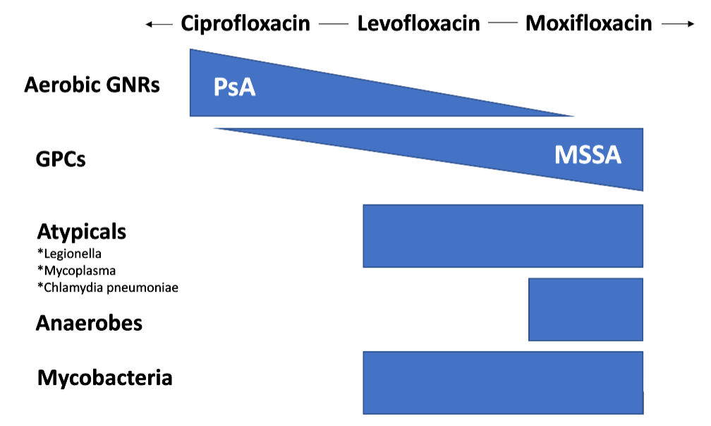
RESPIRATORY FLUOROQUINOLONES

Slide 17
Case 1: Pneumonia
For inpatient Community-Acquired Pneumonia (CAP), use ceftriaxone + azithromycin.
For outpatient Community-Acquired Pneumonia (CAP) in pts with comorbidities, use amoxicillin-clavulanate + azithro. → Alternate: respiratory fluoroquinolone (levofloxacin or moxifloxacin)

Slide 18
Case 1c: Pneumonia
Audience Response Question
What antibiotic(s) would you start?
Ceftriaxone
Cefepime
Vancomycin
Ceftriaxone + Vancomycin
Cefepime + Vancomycin
A 55-year-old patient is hospitalized for chest pain due to an NSTEMI. 7d after admission, they develop fevers, chills, cough, and purulent sputum. A chest XR shows a lobar consolidation.
They are diagnosed with hospital-acquired pneumonia.

Slide 19
Case 1c: Pneumonia
Audience Response Question
What antibiotic(s) would you start?
Ceftriaxone
Cefepime
Vancomycin
Ceftriaxone + Vancomycin
Cefepime + Vancomycin
A 55-year-old patient is hospitalized for chest pain due to an NSTEMI. 7d after admission, they develop fevers, chills, cough, and purulent sputum. A chest XR shows a lobar consolidation.
They are diagnosed with hospital-acquired pneumonia.

Slide 20
Ceftriaxone
What pneumonia pathogens does ceftriaxone miss?
Pseudomonas aeruginosa
Resistant GNRs
MRSA
Slide credit: Drs David Spach and Paul Pottinger

Slide 21
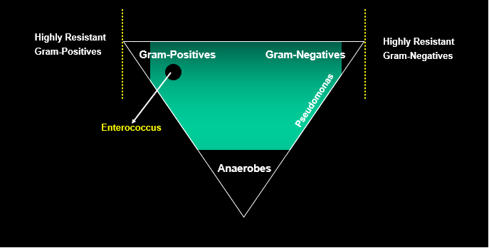
Cefepime
Improved Gram-negative coverage (including Pseudomonas!)
Slide credit: Drs David Spach and Paul Pottinger

Slide 22
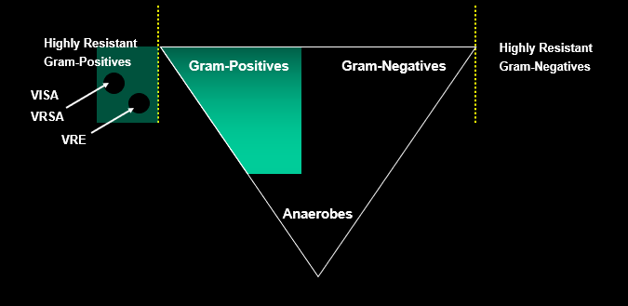
Vancomycin
MRSA coverage!
Slide credit: Drs David Spach and Paul Pottinger

Slide 23
Case 1: Pneumonia
For inpatient Community-Acquired Pneumonia (CAP), use ceftriaxone + azithromycin.
For outpatient Community-Acquired Pneumonia (CAP) in pts with comorbidities, use amoxicillin-clavulanate + azithro. → Alternate: respiratory fluoroquinolone (levofloxacin or moxifloxacin)
For Hospital-Acquired Pneumonia (HAP), use cefepime + vancomycin. → Goal: To additionally cover MRSA, Pseudomonas, more GNRs

Slide 24
Case 2: Urinary Tract Infection (UTI)

Slide 25
Case 2a: UTI
Audience Response Question
What antibiotic would you start?
Ceftriaxone
Cefepime
Vancomycin
Levofloxacin
A 35-year-old cisgender woman with no PMH presents to the ED with fevers, chills, flank pain, and dysuria.
A urinalysis is positive, and a urine culture is pending.
She is diagnosed with pyelonephritis, and admission is planned.

Slide 26
Case 2a: UTI
Audience Response Question
What antibiotic would you start?
Ceftriaxone
Cefepime
Vancomycin
Levofloxacin
A 35-year-old cisgender woman with no PMH presents to the ED with fevers, chills, flank pain, and dysuria.
A urinalysis is positive, and a urine culture is pending.
She is diagnosed with pyelonephritis, and admission is planned.

Slide 27
Ceftriaxone
What UTI pathogens does ceftriaxone cover?
Uropathogenic E coli (~75%!)
Klebsiella (6%)
Proteus (6%)
Staph saprophyticus (6%)
Group B strep (3%)
Slide credit: Drs David Spach and Paul Pottinger

Slide 28
Case 2: Urinary Tract Infection (UTI)
For inpatient UTI in a patient without risk factors for resistance*, use ceftriaxone. → *Risk factors: recent urologic procedure, history of MDRO, etc.

Slide 29
Case 2b: UTI
Audience Response Question
What antibiotic would you send to her pharmacy?
Ceftriaxone
Ciprofloxacin
Amoxicillin
A 35-year-old cisgender woman presents to her primary care physician (PCP) with fevers, chills, flank pain, and dysuria.
A urinalysis is positive, and a urine culture is pending.
She is diagnosed with pyelonephritis, and of course you give a dose of ceftriaxone in the office. Discharge to home is planned.

Slide 30
Case 2b: UTI
Audience Response Question
What antibiotic would you send to her pharmacy?
Ceftriaxone
Ciprofloxacin
Amoxicillin
A 35-year-old cisgender woman presents to her primary care physician (PCP) with fevers, chills, flank pain, and dysuria.
A urinalysis is positive, and a urine culture is pending.
She is diagnosed with pyelonephritis, and of course you give a dose of ceftriaxone in the office. Discharge to home is planned.

Slide 31
Additional benefits of FQ:
High bioavailability
Excellent renal penetration
Can be safely used in bacteremia (PO)

Slide 32
Case 2: Urinary Tract Infection (UTI)
For inpatient pyelonephritis in a patient without risk factors for resistance*, use ceftriaxone. → *Risk factors: recent urologic procedure, history of MDRO, etc.
For outpatient pyelonephritis, use ciprofloxacin or levofloxacin. → Excellent bioavailability and kidney penetration

Slide 33
Case 2c: UTI
Audience Response Question
What antibiotic would you start?
Ceftriaxone
Levofloxacin
Doxycycline
Nitrofurantoin
A 35-year-old cisgender woman presents to her primary care physician (PCP) with urinary frequency, urgency, dysuria, and suprapubic pain.
A urinalysis is positive, and a urine culture is pending.
She is diagnosed with cystitis.

Slide 34
Case 2c: UTI
Audience Response Question
What antibiotic would you start?
Ceftriaxone
Levofloxacin
Doxycycline
Nitrofurantoin
A 35-year-old cisgender woman presents to her primary care physician (PCP) with urinary frequency, urgency, dysuria, and suprapubic pain.
A urinalysis is positive, and a urine culture is pending.
She is diagnosed with cystitis.

Slide 35
Empiric Cystitis Treatment: 3 Options
Nitrofurantoin
Caution with use in elderly or GFR < 30
CAUTION IN UPPER TRACT DISEASE – Does not penetrate kidneys
Fosfomycin
Expensive!
Typically not used for upper tract disease (though data here is evolving!)
TMP/SMX

Slide 36
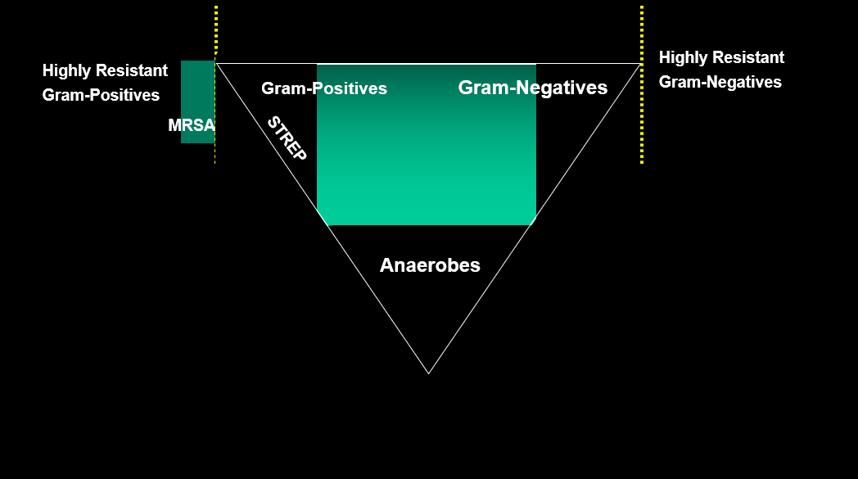
Trimethoprim-Sulfamethoxazole (i.e. “Bactrim” or “TMP-SMX”)
Keep in mind the common UTI pathogens:
Uropathogenic E coli (~75%!)
Klebsiella (6%)
Proteus (6%)
Staph saprophyticus (6%)
Group B strep (3%)
Slide credit: Drs David Spach and Paul Pottinger

Slide 37
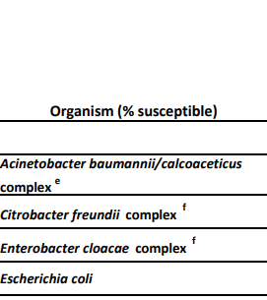
Empiric Cystitis Treatment: 3 Options
Nitrofurantoin
Caution in the elderly or GFR < 30
CAUTION IN UPPER TRACT DISEASE – Does not penetrate kidneys
Fosfomycin
Expensive!
Typically not used for upper tract disease (though data here is evolving!)
TMP/SMX
CAUTION with resistance >20%

Slide 38
Empiric Cystitis Treatment: 3 Options
Nitrofurantoin
Caution in elderly or GFR < 30
CAUTION IN UPPER TRACT DISEASE – Does not penetrate kidneys
Fosfomycin
Expensive!
Typically not used for upper tract disease (though data here is evolving!)
TMP/SMX
CAUTION with resistance >20%
Audience Response Question
Cipro isn’t on the list! Why do you think that is?
Too much resistance
Too expensive
Too many side effects

Slide 39
Empiric Cystitis Treatment: 3 Options
Nitrofurantoin
Caution in elderly or GFR < 30
CAUTION IN UPPER TRACT DISEASE – Does not penetrate kidneys
Fosfomycin
Expensive!
Typically not used for upper tract disease (though data here is evolving!)
TMP/SMX
CAUTION with resistance >20%
Audience Response Question
Cipro isn’t on the list! Why do you think that is?
Too much resistance
Too expensive
Too many side effects

Slide 40
Case 2: Urinary Tract Infection (UTI)
For inpatient pyelonephritis in a patient without risk factors for resistance*, use ceftriaxone. → *Risk factors: recent urologic procedure, history of MDRO, etc.
For outpatient pyelonephritis, use ciprofloxacin or levofloxacin. → Excellent bioavailability and kidney penetration
For cystitis, use fosfomycin or nitrofurantoin. → AVOID fluoroquinolones unless no other options → AVOID empiric bactrim if local E coli resistance > 20%

Slide 41
Case 3: Skin and Soft Tissue Infection (SSTI)

Slide 42
Case 3: SSTI
Audience Response Question
The ED starts vancomycin + ceftriaxone, and they are admitted. How would you narrow antibiotic therapy?
Ceftriaxone
Vancomycin
Cefazolin
A 75-year-old patient presents to the ED after a fall with abrasion on the right lower extremity, followed by development of pain and swelling.
The exam is notable for unilateral erythema, edema, and tenderness to palpation.
They are diagnosed with cellulitis.

Slide 43
Case 3: SSTI
Audience Response Question
The ED starts vancomycin + ceftriaxone, and they are admitted. How would you narrow antibiotic therapy?
Ceftriaxone
Vancomycin
Cefazolin
A 75-year-old patient presents to the ED after a fall with abrasion on the right lower extremity, followed by development of pain and swelling.
The exam is notable for unilateral erythema, edema, and tenderness to palpation.
They are diagnosed with cellulitis.

Slide 44
Cefazolin
Good strep !
An aside: Cefazolin is the gold standard for methicillin-susceptible staph aureus (MSSA).
In terms of coverage: IV cefazolin = PO cephalexin
Slide credit: Drs David Spach and Paul Pottinger

Slide 45
Case 3: SSTI
For non-purulent cellulitis, use: → IV: cefazolin → PO: cephalexin (“Keflex”)

Slide 46
Case 3b: SSTI
Audience Response Question
The ED starts vancomycin + ceftriaxone, and they are admitted. What is the next best step?
Narrow to vanco alone
Narrow to ceftriaxone alone
I&D the abscess
Narrow to vanco + I&D
Narrow to ceftriaxone + I&D
A 75-year-old patient presents to the ED after a fall with abrasion on the right lower extremity, followed by development of pain and swelling.
The exam is notable for unilateral erythema, edema, tenderness to palpation, and a fluctuant fluid collection.
They are diagnosed with cellulitis with soft tissue abscess.

Slide 47
Case 3b: SSTI
Audience Response Question
The ED starts vancomycin + ceftriaxone, and they are admitted. What is the next best step?
Narrow to vanco alone
Narrow to ceftriaxone alone
I&D the abscess
Narrow to vanco + I&D
Narrow to ceftriaxone + I&D
A 75-year-old patient presents to the ED after a fall with abrasion on the right lower extremity, followed by development of pain and swelling.
The exam is notable for unilateral erythema, edema, tenderness to palpation, and a fluctuant fluid collection.
They are diagnosed with cellulitis with soft tissue abscess.

Slide 48
Vancomycin
MRSA coverage!

Slide 49
Case 3c: SSTI
Audience Response Question
They are now ready for discharge. What is the best oral antibiotic option?
Cephalexin
Ciprofloxacin
TMP-SMX (Bactrim)
A 75-year-old patient presents to the ED after a fall with abrasion on the right lower extremity, followed by development of pain and swelling.
The exam is notable for unilateral erythema, edema, tenderness to palpation, and a fluctuant fluid collection.
They are diagnosed with cellulitis with soft tissue abscess.

Slide 50
Case 3c: SSTI
Audience Response Question
They are now ready for discharge. What is the best oral antibiotic option?
Cephalexin
Ciprofloxacin
TMP-SMX (Bactrim)
A 75-year-old patient presents to the ED after a fall with abrasion on the right lower extremity, followed by development of pain and swelling.
The exam is notable for unilateral erythema, edema, tenderness to palpation, and a fluctuant fluid collection.
They are diagnosed with cellulitis with soft tissue abscess.

Slide 51
Trimethoprim-Sulfamethoxazole (i.e. “Bactrim” or “TMP-SMX”)
MRSA coverage!
Poor strep coverage
Slide credit: Drs David Spach and Paul Pottinger

Slide 52
Case 3: SSTI
For non-purulent cellulitis, use: → IV: cefazolin → PO: cephalexin
For purulent cellulitis, use: → IV: vancomycin → PO: trimethoprim-sulfamethoxazole (or doxycycline) → If there is an abscess, drain it!

Slide 53
In summary …
Ceftriaxone – either with or without another antibiotic – is almost always a great start!
Know your resources!
IDSA Guidelines
Quick reference sheets
Hospital- and institution-specific treatment guidelines

Slide 54
Antibiotic Quick Reference
Syndrome | Route | First-Line Rx | Most Common Organisms
Bacterial Meningitis | IV | Ceftriaxone + Vanco ± Ampicillin | Strep pneumoniae, meningo-coccus, ± listeria monocytogenes
Sinusitis | PO | Amoxicillin-Clavulanate | Strep spp, oral anaerobes
Pneumonia | PO | Amoxicillin-Clavulanate + azithro, or Levofloxacin | CAP: Strep pneumoniae, M. catarrhalis, atypical organisms HAP: Consider PsA, MRSA
 | IV | Ceftriaxone + Azithromycin
Intra-abdominal (cholecystitis, diverticulitis) | PO | Ciprofloxacin + Metronidazole | GNRs, anaerobes. Occasionally enterococcus
 | IV | Ceftriaxone + Metronidazole
UTI | PO | Nitrofurantoin, Fosfomycin or Bactrim | E coli, Klebsiella, Proteus, Staph saprophyticus, Group B Strep
 | IV | Ceftriaxone
SSTI | PO | Purulent: TMP-SMX Non-purulent: Cephalexin | Purulent: MRSA, MSSA Non-purulent: Streptococcal spp
 | IV | Purulent: Vanco Non-purulent: Cefazolin

Slide 55
Thank you!
Questions?
Alyssa Castillo: ayc20@uw.edu

