Slide 1
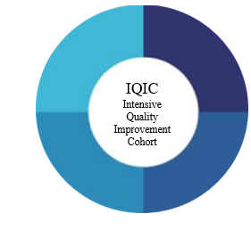
November 17, 2022
Deeper Dive into ASB Cases
Chloe Bryson-Cahn, MD

Slide 2
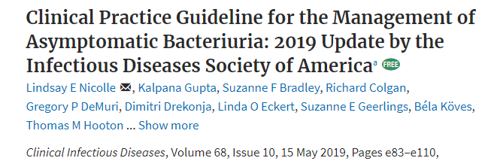
Your Lit Review

Slide 4
Evidence Summary (section V)
Delirious patients have more bacteriuria
Observational data, confounded
Related to host factors
LTCF and Acute Care Data
abx do not improve behavior compared to no abx
treatment of ASB in confused patients –> no mortality benefit
hospitalized elderly patients with delirium
ASB rx -> no improved functional recovery. More CDI.
Delirium waxes and wanes
Nicolle, et al., Clin Infect Dis. 2019 – IDSA ASB Guidelines

Slide 5
Rationale
“We make a strong recommendation because there is high certainty for harm and low certainty of any benefit from treatment of ASB in older adults”
Nicolle, et al., Clin Infect Dis. 2019 – IDSA ASB Guidelines

Slide 6
Case
78 yo seen with altered mental status. No localizing symptoms/physical exam findings. Afebrile. BP wnl.
Labs:
Na 147, Cr 1.3
WBC 8.9
UA: 2+ WBC, trace protein, 2+ bacteria
Gets sent out with 7 days of antibiotics

Slide 7
Know Your Audience
Reasons providers give an antibiotic to this patient
Confusion is a symptom of a UTI and should be treated
Pt had a UTI before and got better with antibiotics
This patient cannot give me a history
What if I miss something?

Slide 8
Confusion is a symptom of a UTI and should be treated
Guidelines – IDSA, AAFP, Urology
Notes:
Plug the tasp link that whitney made

Slide 9
Pt had a UTI before and got better with antibiotics
Cai T, Clin Infect Dis, 2012 Treatment of ASB in young women a/w more UTI

Slide 10
This patient cannot give me a history
These patients ARE included in the studies referenced by the IDSA!
Dasgupta M, Arch Gerontol Geriatr, 2017 – though prefer description in IDSA guidelines

Slide 11
What if I miss something?
What if I miss something?
What will cause more harm?
Sabe N, OFID, 2021 - RCT in kidney transplant recipients

Slide 12
Case
78 yo patient with a chronic foley catheter presents to the ED for a fall. Urine is cloudy, foul smelling.
Labs:
Na 147, Cr 1.3
WBC 8.9
UA: 3+ WBC, trace protein, 2+ bacteria
Gets sent out with 14 days of antibiotics

Slide 13
Know Your Audience
Reasons providers give an antibiotic to this patient and how would you respond

Slide 14
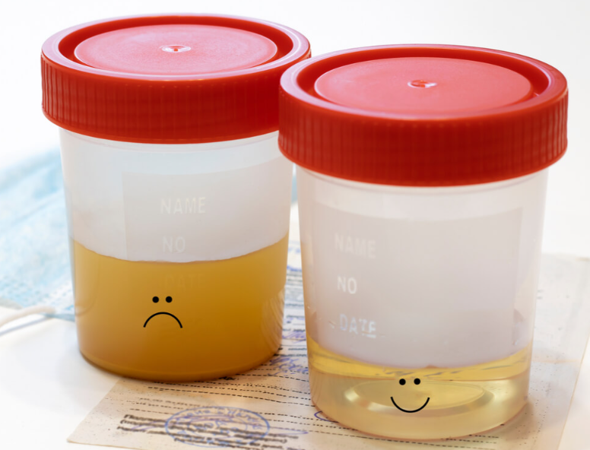
Is it the system?
Image from: Everything You Should Know About Cloudy Urine - HealthifyMe

Slide 15
Is it the culture?

Slide 16
References
Clinical Practice Guideline for the Management of Asymptomatic Bacteriuria: 2019 Update by the Infectious Diseases Society of America (idsociety.org)
Asymptomatic Bacteriuria - American Family Physician (aafp.org)
Thenounproject.com for icons

