Slide 1
Toolkit: Skin & Soft Tissue Infections
Theodore Wright, MD
UW Medicine | Harborview Medical Center
tcw2@uw.edu
March 20, 2018

Slide 2
Overview
What are SSTIs?
What is the Problem?
How to diagnosis SSTI
How to treat SSTI
Opportunities for Stewardship within SSTI
SSTI orderset example

Slide 3
SSTI Flavors
Impetigo
Folliculitis
Furuncles, Carbuncles
Erysipelas, cellulitis, pyomyositis, and fasciitis
Notes:
Erisypelas is more superficial than cellulitis and involves lymphatics. Most often GAS. Well demarcated. Peau d’orange.
Cellulitis effects dermis and subcutaneous fat.

Slide 4
SSTI Flavors
Impetigo
Usually children. Used to be caused by GAS. Now mostly S.aureus. Can be treated with chlorhexidine and topical bacitracin/polymyxin B/neomycin.
Folliculitis:
Pyoderma of the dermis surrounding a hair follicle. Can be treated without antibiotics.
Erysipelas:
Superficial cellulitis. Dull pain. Prominent lymphatic involvement (peau d’orange). Geographic appearance with raised borders and well demarcated.
Cellulitis:
less well demarcated than erysipelas and more painful.
Fasciitis:
Infection of the fascia. Often seen as necrotizing fasciitis. Surgical emergency.
Pyomyositis:
Infection of the muscle. Often abscess forming. Often S.aureus.

Slide 5
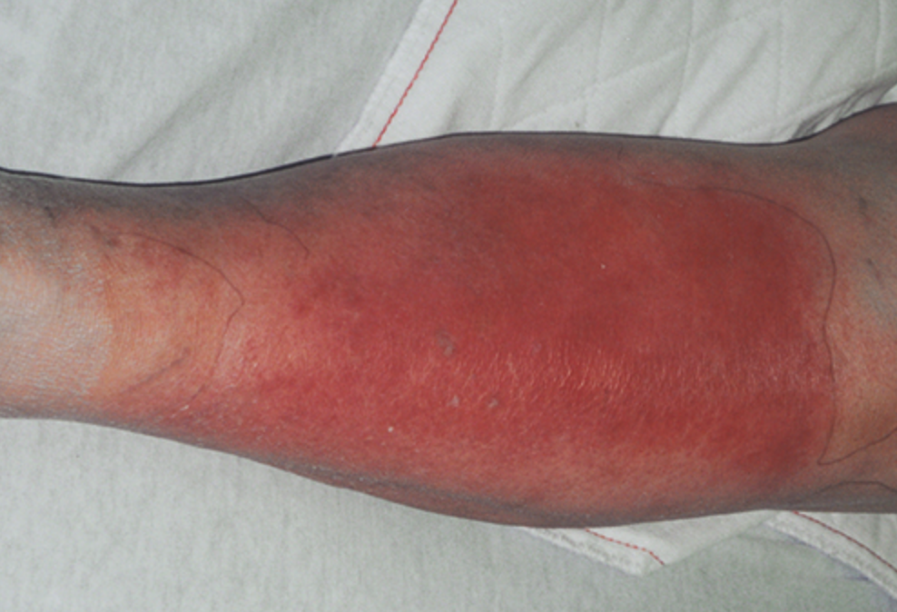
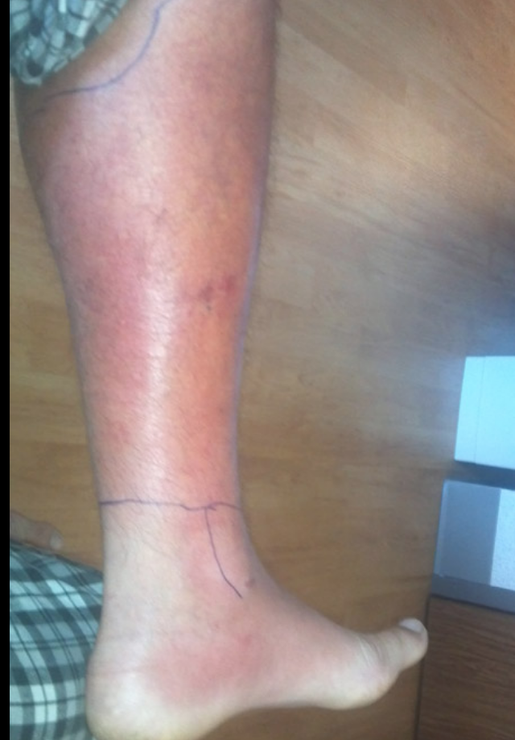
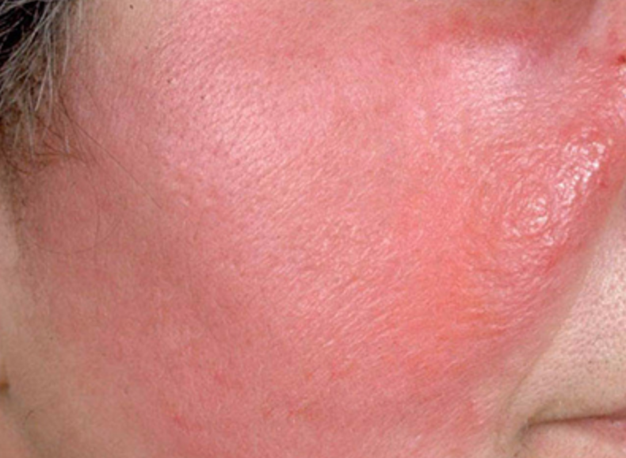
SSTI Flavors
Spelman, D. Cellulitis and Skin Abscesses. UpToDate. March 8, 2018. Viewed March 14, 2018
Wikipedia. Cellulitis. Viewed March 14, 2018.

Slide 6
SSTI Pyramid
Special
Aeromonas, Vibrio, Mycoplasma, NTM
Pseudomonas, GNR, anaerobes
RF – Age, Liver disease, Renal disease, DM, Immune status, occupation
⬆️ CA-MRSA
😀
Staphylococcus aureus
Streptococcus pyogenes, GAS
Notes:
Hard to say determine epi because cellulitis is so rarely cultured.
Likely etiology varies largely with RF and immue status. Lymphedema. ,liver failure, renal failure, diabetes, HIV, transplant patients, et.
Most common cause is beta hemolytic strep with GS the most common of those.

Slide 7
SSTI Flavors
MRSA
Pseudomonas
😱
Strep Pyogenes
MSSA
Anaerobes

Slide 8
Is there really a problem?

Slide 9
SSTIs
>700,000 hospitalizations per year
~65% increase since 1999 4 million ER visits in 2010.
So many admissions! Mimics
Such long duration! Often 10-14 days…
Serious consequences: Resistance, SJS, hyperkalemia, renal failure, neuropathy, C diff.
Gibbson, JA; et al. Antimicrobial Stewardshipin the Treatment of Skin and Soft Tissue Infections. Am J of Inf Contr. 45 (2017)
Walsh, TL; et al. Appropriateness of Antibiotic Management of Uncomplicated SSTI in hospitalized adults. BMC Infectious Diseases. 2016.
Notes:
Pneumonia and SSTI mostfrustrating diagnoses for a hospitalist. So subjective. So many mimics! Hard to diagnose and treat.
2nd most common admission.
Mimics: Gout, venous stasis, thrombus, lymphedema, malignancy, auotimmune.
Duration should be 5-7 days but often treated for 10-14

Slide 10
Mild non-purulent disease: 21% admitted, 88% of those got vanco and pip/tazo, 36% of discharged did not receive appropriate abx..
Mild purulent SSTI: 44% treated as outpatient had I & D but then 100% of those were then given abx inappropriately. Of those admitted 0% received appropriate abx course.
43% of purulent SSTIs overall received appropriate abx.
Mod/Severe disease: 21-24% given inappropriate abx.
Non-purulent SSTI: 29% given wrong abx in ED.
Severe disease with sepsis: 34% discharged to home!
Notes:
Not only are we choosing the wrong abx but we are giving them for way too long!

Slide 11
Uncomplicated SSTI only = No RF for GNR or anaerobic infection and not admitted to the ICU.
Only 20% received an appropriate duration of antibiotics; <10 d.
51% received 10-14 days of abx.
28% received >14d abx.

Slide 12
Top 3 Myths of SSTI
Myth 1: All that is red and swollen is cellulitis.
Raise the leg and if erythema abates within 1-2 minutes then it is unlikely to be cellulitis.
Myth 2: My patient has bilateral LE cellulitis.
This is not a thing.
Myth 3: All SSTI require systemic abx:
Impetigo can be treated with topical abx.
Simple abscesses that are drained may not require abx.
Myth 4: Longer is better
Myth 5: My patient needs pip/tazo
Myth 6: My patient is failing outpatient treatment and needs IV vancomycin in the hospital.
Mcreary et al. Top 10 myths regarding the diagnosis and treatment of cellulitis. Journal of Emergency Medicine. 53(4). 2017
Notes:
Disclaimer: Myths 4-6 are mine.
Duration should be 5 days….but the average Is double that.

Slide 13
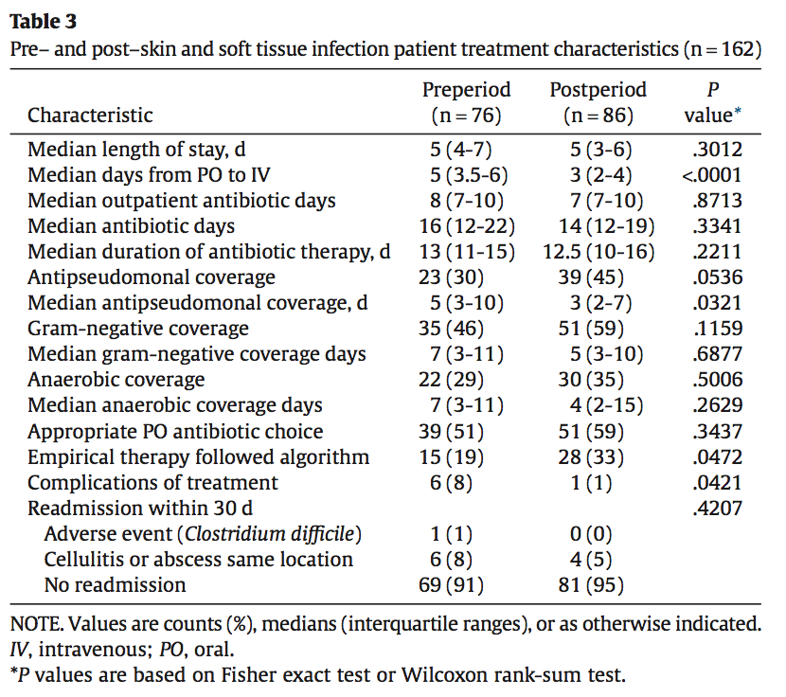
Interventions
Provider Education and ordersets/algorithms
Earlier conversion to PO
Results:
Increased adherence to evidence based abx choices
Reduced readmission and complications
Increased Anti-PsA coverage but shorter duration

Slide 14
Diagnosis
Clinical diagnosis!
Do culture…
Purulent debris when performing I and D.
Do not to culture…
Chronic ulcer beds.
Aspirate of cellulitis or erysipelas.
Get blood cultures if…
Systemically ill; septic.
Immunosuppressed
Bite or trauma
Failing to respond to therapy
Stevens, DL. Practice Guidelinesfor Diagnosis and Management ofSSTI. IDSA. 2014.

Slide 15
Treatment
Notes:
PSSTI mild: Tx only I and D. PSSTI mod defined as purulence with a systemic sign of infection. Severe PSSTI is failed I and D plus oral abx or who have systemic signs of infectionor are immunocompromised.
NPSSTI mild has no foxus of purulence. Mod NPSSTI has a systemic sign of infection. Severe NPSSTI have failed oral abx or have sepsis or immunocompromized.

Slide 16
Treatment of non-purulent SSTI
Raff, AB; Kroshinsky, D. Cellulitis: A Review. JAMA. 2016. 316(3).
Notes:
Calculate LRINEC score for severe nonpurulent cellulitis. JAMA. 2016. 316(3).

Slide 17
Treatment of Purulent SSTI
Raff, AB; Kroshinsky, D. Cellulitis: A Review. JAMA. 2016. 316(3).

Slide 18
TMP/SMX v placebo for uncomplicated abscesses drained in the ED.
7 days of 2 DS tabs TMP/SMX PO BID!
Improved clinical cure and reduced rates of readmission or complications at 30 days.
No serious adverse events; i.e. renal failure or SJS.

Slide 19
Uncomplicated abscess, <5 cm.
S.aureus isolated in 67% of cx. 49% MRSA.
Given 10 days of TMP/SMX DS 1 tab PO BID.
Improved cure rate compared to placebo at 10 days post-drainage.

Slide 20
Another Time…
NSTI
Diabetic foot wounds
Animal Bites
Water Exposures

Slide 21
Ordersets
Notes:
Duration is missing!

Slide 22
Ordersets

Slide 23
Ordersets
Notes:
ADD duration!

Slide 24
Acknowledgements
Thank you Tyler Fischback for the excellent SSTI orderset examples.

