Slide 1
Antimicrobial Stewardship:
Physician Update
2017-2018

Slide 2
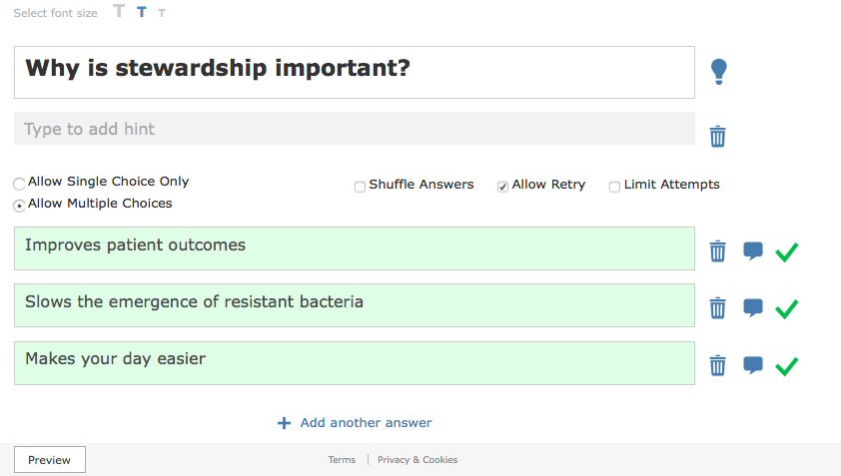

Slide 3
Antimicrobial Stewardship:
Improving Patient Outcomes
Using standardized guidelines based on local data for infectious disease syndromes, including empiric antimicrobials, dosing, diagnostic assays and interpretation of results, de-escalation/duration and discontinuation of antimicrobials is associated with better patient outcomes, including:
  Decreased mortality
  Decreased length-of-stay
  Decreased adverse events
  Fewer Clostridium difficile infections
Akpan, M. R., et al. A Review of Quality Measures for Assessing the Impact of Antimicrobial Stewardship Programs in Hospitals. Antibiotics (Basel) 5, (2016).

Slide 4
Antimicrobial Stewardship:
Slowing the Emergence of Resistant Bacteria
Drug-resistant bacteria are the result of selection by antimicrobials used in human and animal health and present in the environment. Reduced antimicrobial exposure will decrease this selection pressure and will slow the emergence of more drug-resistant bacteria.
Patients with infections due to drug-resistant bacteria are sicker and die more frequently compared to patients with susceptible bacterial infections.

Slide 5
CRKP=carbapenem-resistant K. pneumoniae
CSKP=carbapenem-sensitive K. pneumoniae
Patel, G., et al. Outcomes of carbapenem-resistant Klebsiella pneumoniae infection and the impact of antimicrobial and adjunctive therapies. Infect. Control Hosp. Epidemiol. 29, 1099–1106 (2008).

Slide 6
Antimicrobial Stewardship:
Makes Your Day Better
Physicians excel in history-taking, physical exam, procedures, data analysis/synthesis and diagnosis, but usually cannot keep up with every ID guideline and new micro test
The best clinical care is the result of a team of clinicians and support staff
A multidisciplinary antimicrobial stewardship team supports clinicians by:
  Making it easier to link local microbiological data, such as susceptibility patterns, to treatment recommendations and guidelines
  Improving diagnostic assay use and interpretation
  Recognizing opportunities for de-escalation and discontinuation of antimicrobials
  Providing useful information

Slide 7
Please call the ASP with questions.
Thanks!

Slide 8
References
Akpan, M. R., Ahmad, R., Shebl, N. A. & Ashiru-Oredope, D. A Review of Quality Measures for Assessing the Impact of Antimicrobial Stewardship Programs in Hospitals. Antibiotics (Basel) 5, (2016).
Patel, G., Huprikar, S., Factor, S. H., Jenkins, S. G. & Calfee, D. P. Outcomes of carbapenem-resistant Klebsiella pneumoniae infection and the impact of antimicrobial and adjunctive therapies. Infect. Control Hosp. Epidemiol. 29, 1099–1106 (2008).

