Slide 1
August 6, 2019
Agenda
Gram-negative Bacteremia Part II
Case Discussions
Open Discussion

Slide 2
Gram-negative Bacteremia
Part II
Jeannie Chan, PharmD, MPH
UW Medicine | Harborview Medical Center
August 6, 2019

Slide 3
Agenda
Goal: Discuss optimal treatment and duration, and management of GNR bacteremia
1.) How long to treat?
2.) Oral antibiotic as step-down?
3.) Repeat blood cultures?

Slide 4
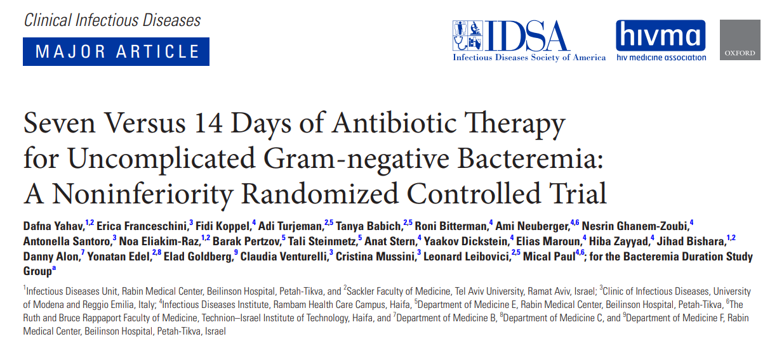
Duration – Less is More….

Slide 5
Oral antibiotic step-down
Percent (%)
64% (7-d) and 81%( 14-d) groups received oral antibiotics
Yahav et al. Clin Infect Dis. 2018 Dec 11.

Slide 6
Patient population
PATIENTS | SOURCE
BACTERIAL ORGANISM
71 years old 50% female
20-25% urinary device
25% malignancy
60% independently functional
Yahav et al. Clin Infect Dis. 2018 Dec 11.

Slide 7
A 57 yo female presents to your ED with sepsis. Urine and blood cultures grow P. aeruginosa
On Day 3, the patient is stabilized. What duration of therapy would you recommend to complete a course.
7 days
10 days
14 days
21 days

Slide 8
Pseudomonas aeruginosa Bacteremia – How long is long enough?
Primary Endpoint:
Recurrent P. aeruginosa infections or death within 30 days of stopping antibiotic
Fabre V, et al. Clin Infect Dis 2019

Slide 9
Patient population
PATIENTS | SOURCE
Over 93% had source control Median duration of bacteremia = 1 day Median Pitts bacteremia score = 2
61-66 years old
34-38%% female
30-33% ICU stay
20-22% HD
14-16% DM
Immunocompromised:
11-12% immunosuppressive therapy
18-21% chemo past 6 months
14-17% stem cell transplant past year
Fabre V, et al. Clin Infect Dis 2019

Slide 10
“Less is More” also applies to Pseudomonas aeruginosa
 | Short Course (n=72) | Long Course (n=179) | P-value
Median Duration (days) | 9 | 16 | ---
Transition to oral FQ | 27 (37%) | 62 (35%) | ---
Median days to oral FQ | 5 | 6 | ---
Composite: Recurrent infection or mortality | 10 (14%) | 24 (13%) | 0.91
Recurrence | 5 (7%) | 20 (11%) | >0.05
30d mortality | 5 (7%) | 6 (4%) | >0.05
Hospital length of stay (days) |  | Difference: 4d 95% CI: (1.3-6.8) | 0.005
Fabre V, et al. Clin Infect Dis 2019

Slide 11
Benefits of oral antibiotic
Reduce hospital length of stay
Improve quality of life
Discomfort of IV catheter
Improve mobility
Perception of health and functional capacity
Decrease risk of infectious and non-infectious catheter associated complications
Decrease medication costs
IV drug preparation and administration cost
Tamma PD, et al. JAMA Internal Medicine 2019;179:316-323

Slide 12
Inpatient adults with GNR bacteremia with source control, Pitt bacteremia score < 1, taking orals, in vitro active oral abx options
Propensity score matched cohort (1:1)
Oral step-down therapy Median IV therapy: 3d
N = 739
Intravenous therapy: N = 739
PRIMARY OUTCOME: 30-day mortality
SECONDARY OUTCOMES: 30-day recurrent bacteremia, hospital LOS
Mortality: 13.1% Recurrent bacteremia: 0.8% Median hospital LOS: 3 day
(p<0.001)
Mortality: 13.4% Recurrent bacteremia: 0.5% Median hospital LOS: 7 day
Tamma PD, et al. JAMA Internal Medicine 2019;179:316-323

Slide 13
Patient population
PATIENTS | SOURCE
BACTERIAL ORGANISM
59 years old 52% male
Median abx: 14 days
28% rec’vd chemo (past 6 mos)
11% solid organ
transplant
Tamma PD, et al. JAMA Internal Medicine 2019;179:316-323

Slide 14
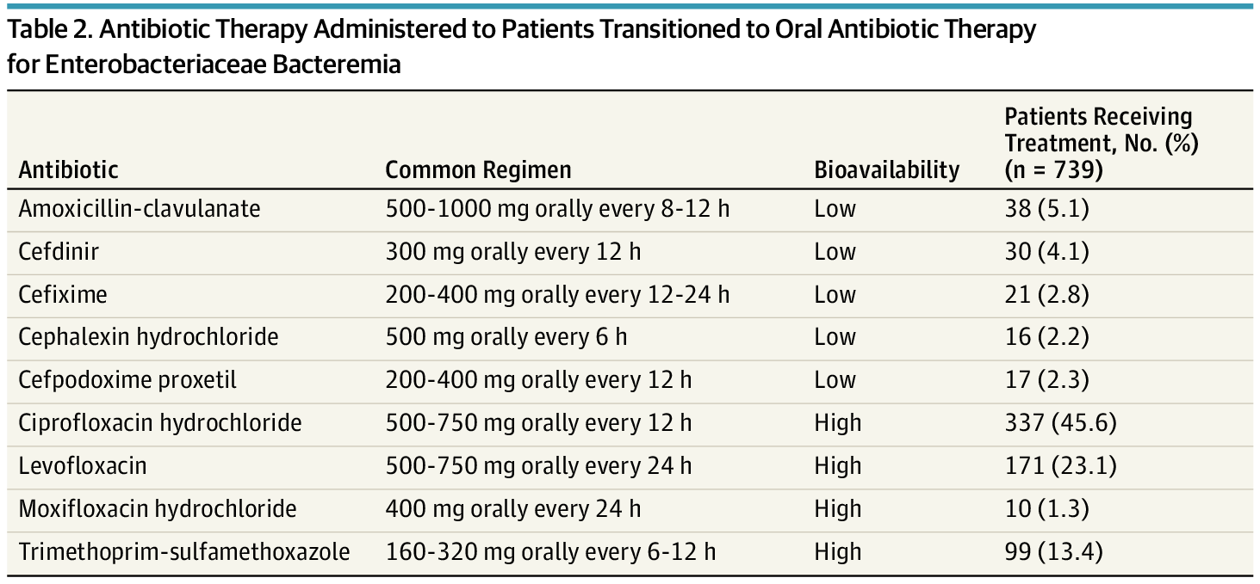
From: Association of 30-Day Mortality With Oral Step-Down vs Continued Intravenous Therapy in Patients Hospitalized With Enterobacteriaceae Bacteremia
JAMA Intern Med. 2019;179(3):316-323. doi:10.1001/jamainternmed.2018.6226
70% FQ
 | High Bioavailability N = 617 (%) | Low Bioavailability N = 122 (%)
30-day mortality | 68 (11) | 15 (12)
Recurrent bacteremia | 4 (0.6) | 0 (0)

Slide 15
Highly Bioavailable N = 106 | Moderately Bioavailable N = 179 | Low Bioavailable N = 77
Levofloxacin | Ciprofloxacin SMX/TMP | Beta-lactams

Slide 16
Adults with GNR bacteremia discharged with oral antibiotics
70% urinary source, 67% E.coli
(Abx duration = 4.7d (IV), 9.1d (oral) N = 362
HIGH BIOAVAILABLE Levofloxacin N = 106
MOD. BIOAVAILABLE Ciprofloxacin, SMX/TMP N = 179
LOW BIOAVAILABLE Beta-lactams N = 77
TREATMENT FAILURE (within 90 days): All-cause mortality OR recurrent infection
HIGH BIOAVAILABLE 2%
MOD. BIOAVAILABLE 12%
LOW BIOAVAILABLE 14%
HIGH AND MOD. BIOAVAILABLE ??? (102 censored, loss of follow up)

Slide 17
β-lactam vs. FQ as step-down
Study population:
224 adults with bacteremia after 3d of IV antibiotics, stepped down to orals
74% E. coli; 17% Klebsiella pneumoniae
Oral beta lactam (n=84); amox/clavulanate, cephalexin, amoxicillin, cefdinir
FQ (n=140); ciprofloxacin > levofloxacin > moxifloxacin
Primary outcome: clinical success adjudicated by two investigators (blinded)

Slide 18
β-lactam vs. FQ as step-down
Mercuro NJ et al. International J of Antimicrobial Agents 2018;51:687-692

Slide 19
Summary: Oral antibiotics
Growing evidence that oral antibiotics are effective as step-down therapy
Comparative data between individual oral antibiotics
Lack statistical power
Endpoints are somewhat different among studies
Confounded by indication
Majority of data are FQ-based regimen
Consider SMX/TMP, 90% bioavailable
β-lactam if no other options

Slide 20
Do we need follow up blood culture to document clearance for GNR?
Yes
No
Not sure

Slide 21
Of 500 patients with bacteremia, 383 (77%) had follow up blood cultures (FUBC)
Of 140 Gram-negative bacteremia, only 8 (6%) had positive FUBC
Takes 17 FUBC to yield 1 positive result

Slide 22
Repeat cultures are low yield for UTI

Slide 23
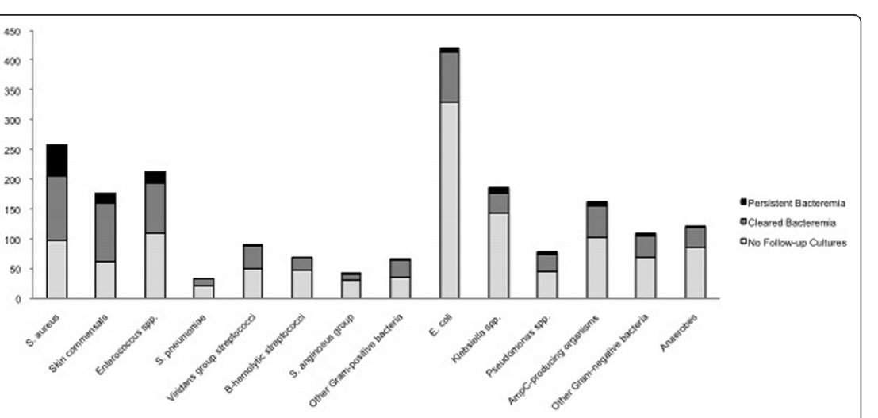
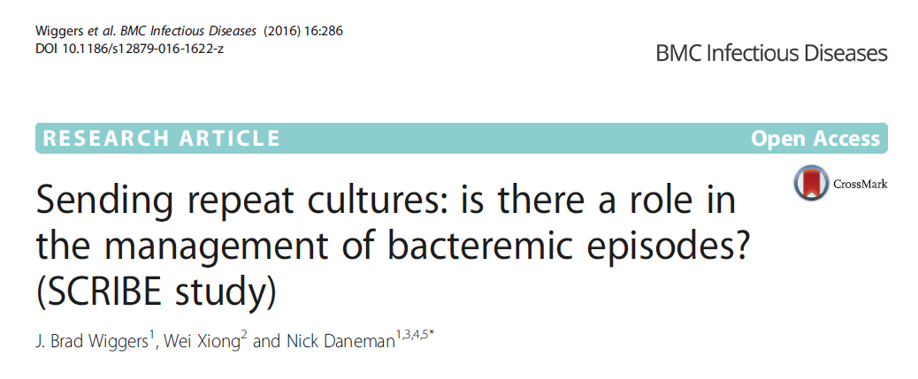
E. coli rarely leads for persistent bacteremia
5%
Number of cases of bacteremia
S. aureus
E. coli
Skin commensals
Enterococcus spp.
Wiggers et al. 2016 BMC Infect Dis. 16:286

Slide 24
Take-home Messages
Seven days for Gram-negative bacteremia
Source controlled
Signs of clinical improvement
Antibiotic selection
Based on organism susceptibility
Oral step-down: Fluoroquinolones/Bactrim
No need to repeat blood cultures for clearance
Unless: fever, uncontrolled source (e.g. endovascular, undrained source)

