Slide 1
August 6, 2019
Agenda
Gram-negative Bacteremia Part I
Case Discussions
Open Discussion

Slide 2
Gram-negative Bacteremia
Part I
Jeannie Chan, PharmD, MPH
Zahra Kassamali Escobar, PharmD, BCIDP
UW Medicine | Harborview and Valley Medical Centers
August 6, 2019

Slide 3
Agenda
Goal: Discuss optimal treatment and duration, and management of GNR bacteremia
1.) How long to treat?
2.) Oral antibiotic as step-down?
3.) Repeat blood cultures?

Slide 4

Gram Negatives
E. coli
Klebsiella spp.
Proteus spp.
Enterobacter spp.
Citrobacter spp.
Serratia spp.
± P. aeruginosa

Slide 5
A 62 yo female presents to your hospital with sepsis. Urine and blood cultures grow E. coli
On Day 3, the patient is stabilized. What duration of therapy would you recommend to complete a course.
5 days
7 days
10 days
14 days

Slide 6



What drives duration of therapy?
History, the Solar System, and a Human hand
-Babylonians held the number 7 in mystical significance
-Ancient Chinese and Japanese based 7-day cycles on celestial bodies (Sun, Moon, Mars, Mercury, Jupiter, Venus and Saturn)
-Judaism, the world was created in 7 days
AD 321: 7-day week is formally codified by the Romans
Constantine
JAMA Intern Med. 2016 Sep 1; 176(9): 1254–1255.
http://www.bbc.co.uk/religion/0/20394641

Slide 7
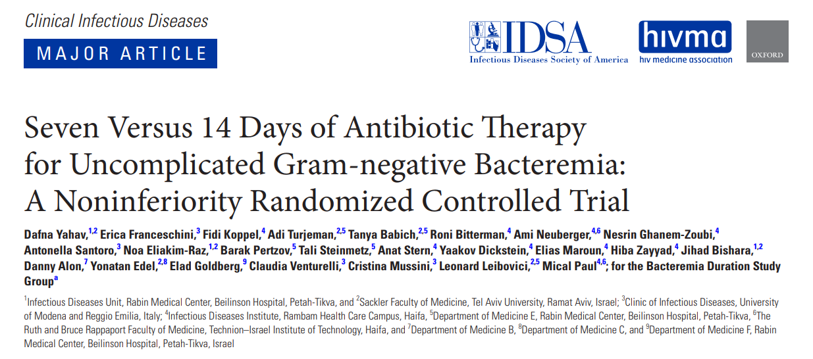
Duration – Less is More….

Slide 8

Patient population
PATIENTS | SOURCE
BACTERIAL ORGANISM
71 years old 50% female
20-25% urinary device
25%
malignancy
60%
independently functional
Yahav et al. Clin Infect Dis. 2018 Dec 11.

Slide 9
Inpatient adults with GNR bacteremia, afebrile & hemodynamically stable x48h
N = 604
CONTROL GROUP:
14 days of antibiotics
N = 298
TREATMENT GROUP:
7 days of antibiotics
N = 306
PRIMARY OUTCOME (composite endpoints within 90 days):
All-cause mortality ▪ Relapse of bacteremia ▪ Local/distant infectious complications ▪ Readmission ▪ Extended hospital stay > 14 days
14-DAY TREATMENT: 48%
Mortality: 10.7%
Readmission: 42.6%
LOS >14 d: 6.4%
Relapse BSI: 2.7%
Complications: 3.7%
7-DAY TREATMENT: 46%
Mortality: 11.8%
Readmission: 38.9%
LOS >14 d: 4.9%
Relapse BSI: 2.6%
Complications: 5.9%

Slide 10
The patient is ready for discharge but has 4 days on antibiotic therapy remaining.
What oral agent would you recommend?
Amoxicillin/clavulanate
Cefpodoxime
Levofloxacin
Sulfamethoxazole/trimethoprim

Slide 11
Oral antibiotic step-down
Percent (%)
64% (7-d) and 81%( 14-d) groups received oral antibiotics
Yahav et al. Clin Infect Dis. 2018 Dec 11.

Slide 12
A 57 yo female presents to your ED with sepsis. Urine and blood cultures grow P. aeruginosa
On Day 3, the patient is stabilized. What duration of therapy would you recommend to complete a course.
7 days
10 days
14 days
21 days

Slide 13
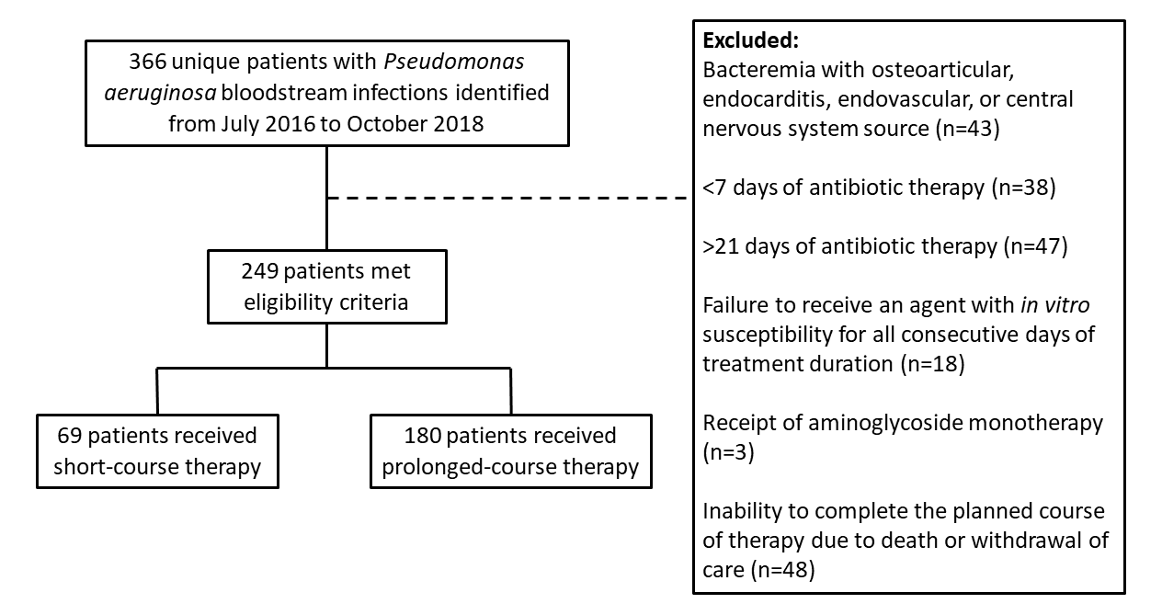
Pseudomonas aeruginosa Bacteremia – How long is long enough?
Primary Endpoint:
Recurrent P. aeruginosa infections or death within 30 days of stopping antibiotic
Fabre V, et al. Clin Infect Dis 2019

Slide 14
Patient population
PATIENTS | SOURCE
Over 93% had source control Median duration of bacteremia = 1 day Median Pitts bacteremia score = 2
61-66 years old
34-38%% female
30-33% ICU stay
20-22% HD
14-16% DM
Immunocompromised:
11-12% immunosuppressive therapy
18-21% chemo past 6 months
14-17% stem cell transplant past year
Fabre V, et al. Clin Infect Dis 2019

Slide 15
“Less is More” also applies to Pseudomonas aeruginosa
 | Short Course (n=72) | Long Course (n=179) | P-value
Median Duration (days) | 9 | 16 | ---
Transition to oral FQ | 27 (37%) | 62 (35%) | ---
Median days to oral FQ | 5 | 6 | ---
Composite: Recurrent infection or mortality | 10 (14%) | 24 (13%) | 0.91
Recurrence | 5 (7%) | 20 (11%) | >0.05
30d mortality | 5 (7%) | 6 (4%) | >0.05
Hospital length of stay (days) |  | Difference: 4d 95% CI: (1.3-6.8) | 0.005
Fabre V, et al. Clin Infect Dis 2019

Slide 16

Benefits of oral antibiotic
Reduce hospital length of stay
Improve quality of life
  Discomfort of IV catheter
  Improve mobility
  Perception of health and functional capacity
Decrease risk of infectious and non-infectious catheter associated complications
Decrease medication costs
  IV drug preparation and administration cost
Tamma PD, et al. JAMA Internal Medicine 2019;179:316-323

Slide 17
Do we need follow up blood culture to document clearance for GNR?
Yes
No
Not sure

Slide 18
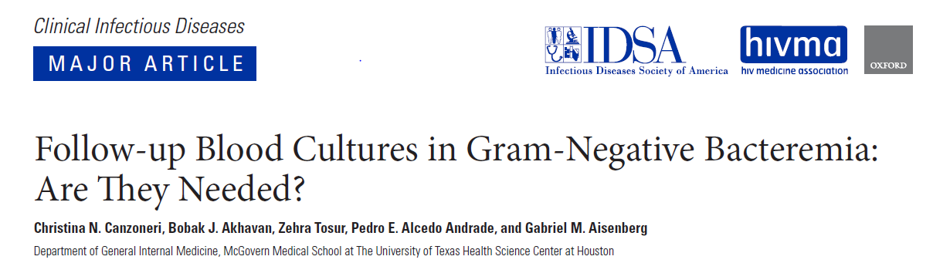
Of 500 patients with bacteremia, 383 (77%) had follow up blood cultures (FUBC)
Of 140 Gram-negative bacteremia, only 8 (6%) had positive FUBC
Takes 17 FUBC to yield 1 positive result

Slide 19
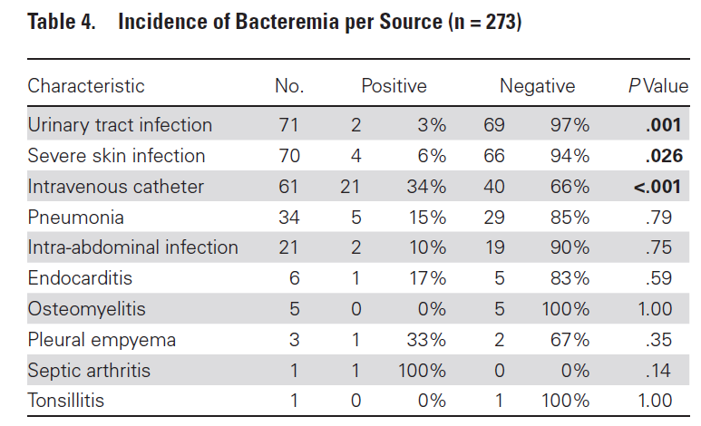
Repeat cultures are low yield for UTI

Slide 20
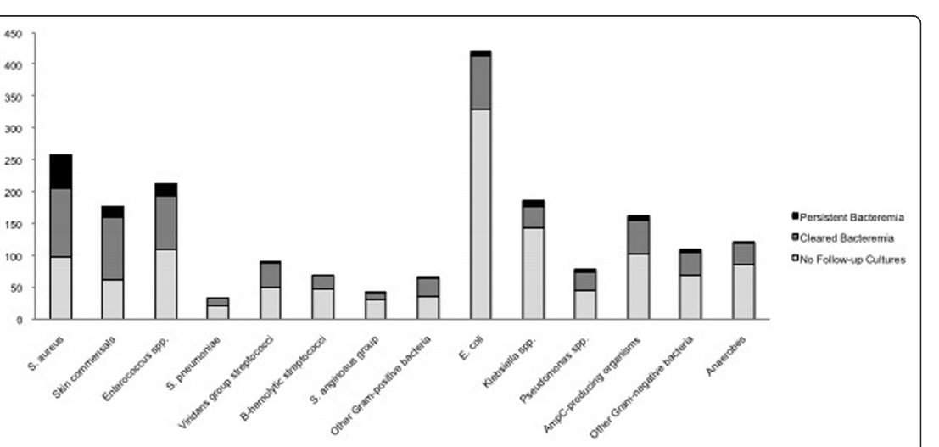
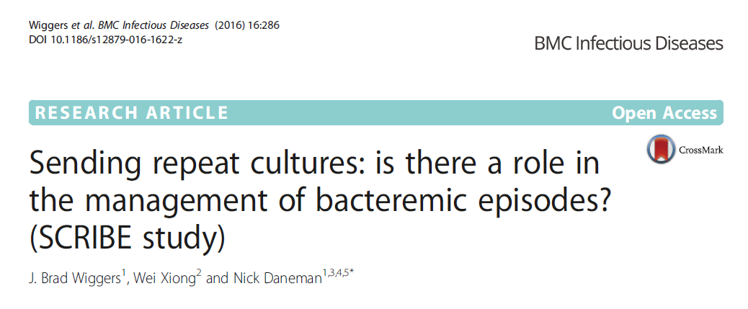
E. coli rarely leads for persistent bacteremia
5%
Number of cases of bacteremia
S. aureus
E. coli
Skin commensals
Enterococcus spp.
Wiggers et al. 2016 BMC Infect Dis. 16:286

Slide 21
Take-home Messages
Seven days for Gram-negative bacteremia
  Source controlled
  Signs of clinical improvement
Antibiotic selection
  Based on organism susceptibility
  Oral step-down: Fluoroquinolones/Bactrim
No need to repeat blood cultures for clearance
  Unless: fever, uncontrolled source (e.g. endovascular, undrained source)

