Slide 1
P&T: Good, Bad, or Ugly?
Rupali Jain, PharmD
Paul Pottinger, MD, FIDSA
Associate Professor
UW Medical Center

Slide 2
Audience
Question…
Do you participate in the pharmacy and therapeutics committee?
Yes
No
I don’t know
Paul Pottinger MD

Slide 3
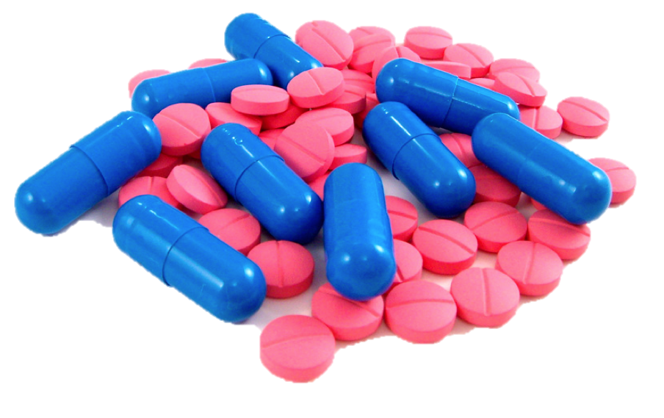
P&T: “What is it good for?”
Pharmacy & Therapeutics
Purpose: maintain formulary
Represents the clinical judgment of providers and pharmacists in the diagnosis, prophylaxis or treatment of disease and promotion of health.
Ongoing process to systemically review drug therapies and drug related products to identify the most medically appropriate and cost-effective therapy for a given population.
Examples: Medicare, Medicaid, your hospital
3

Slide 4
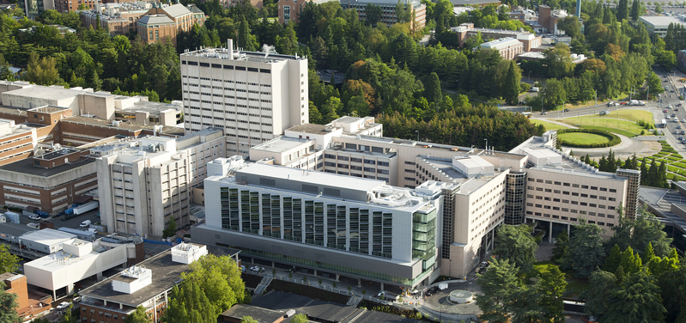
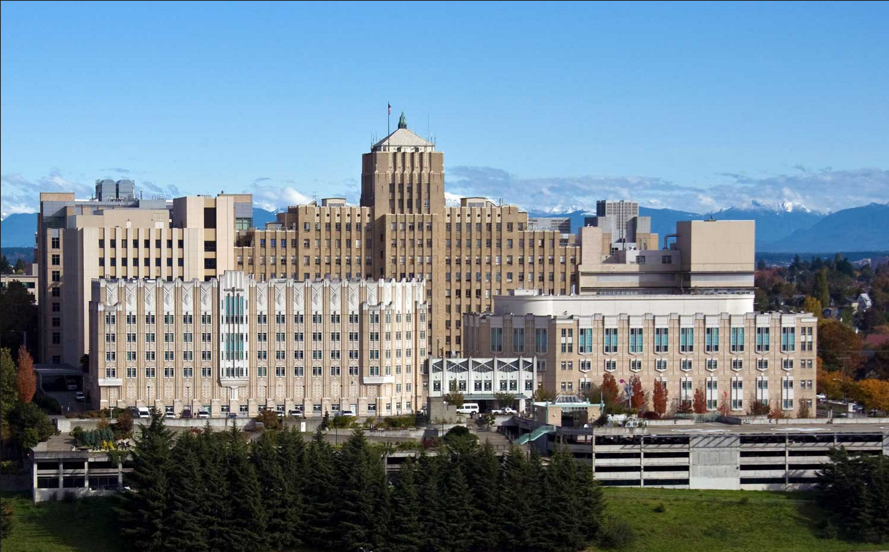
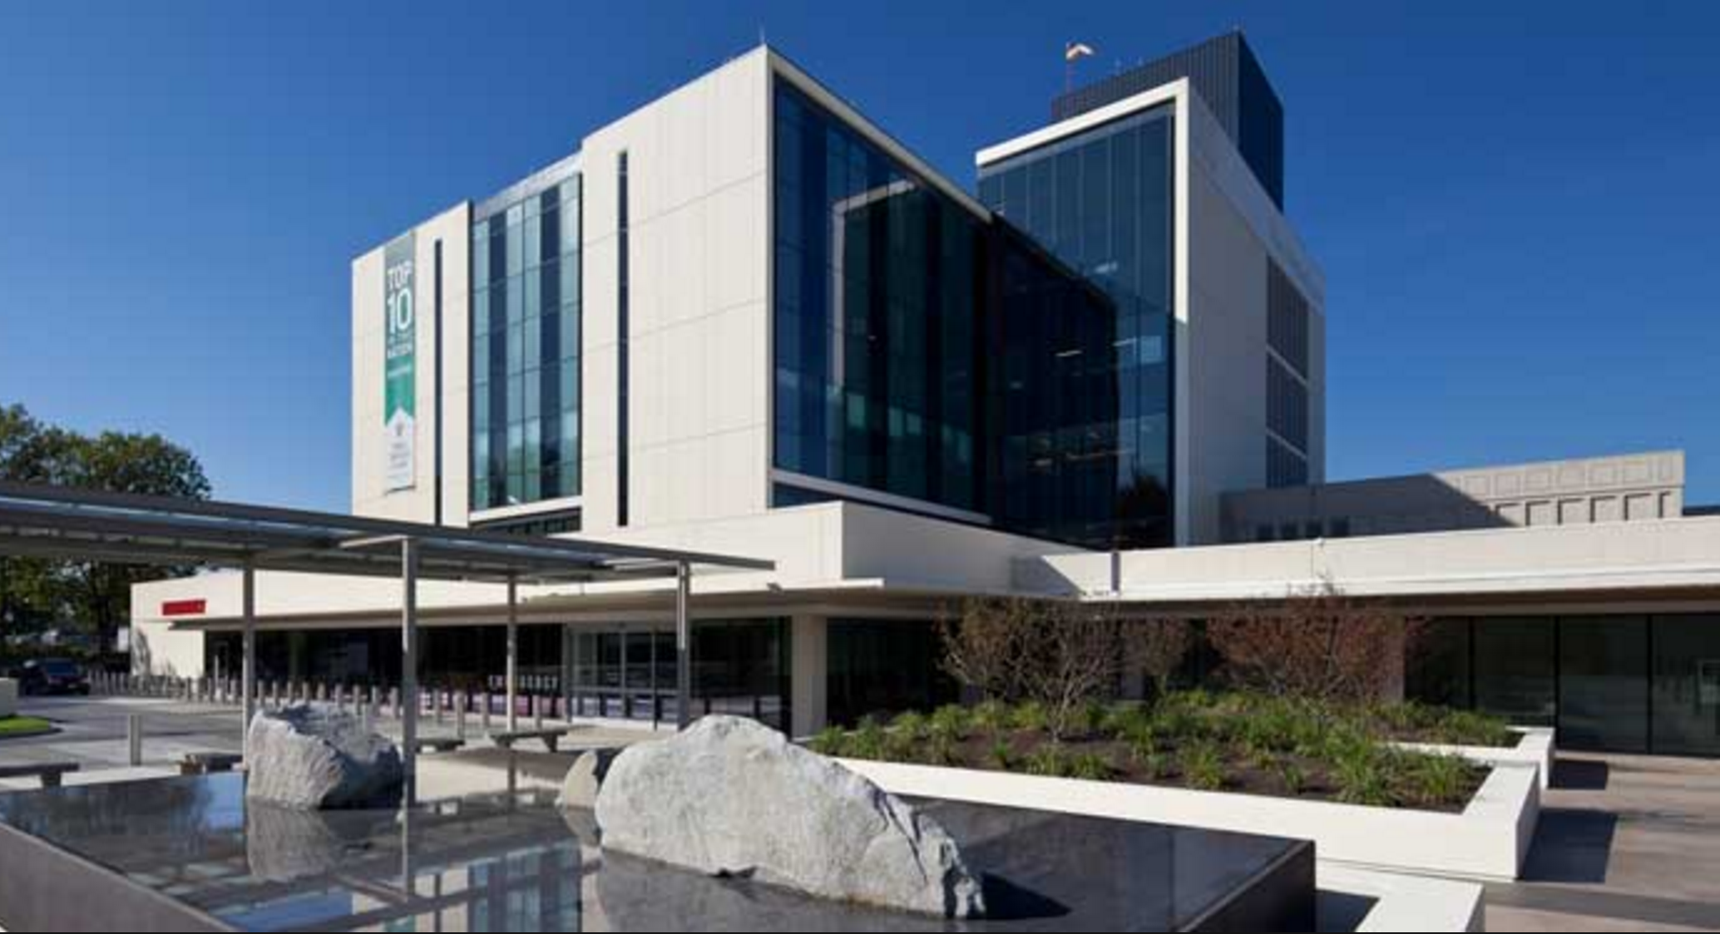
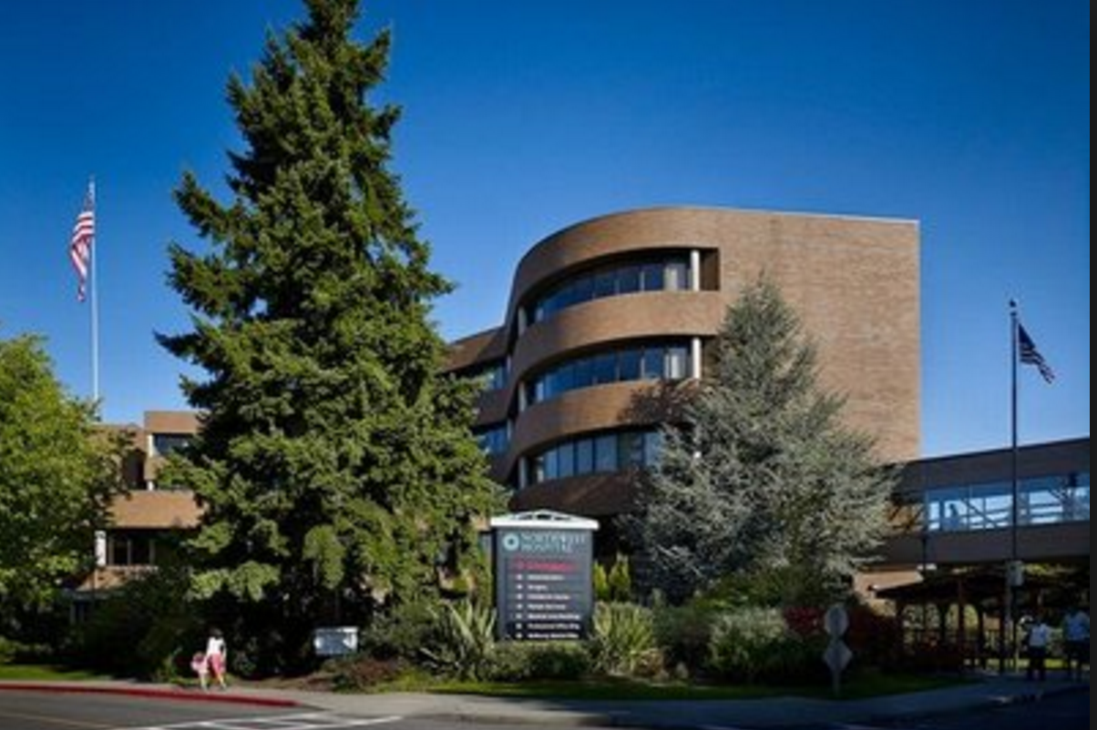
P&T: “What is it good for?”
Pharmacy & Therapeutics
A key tool for ASP
How to do it….
Who is involved?
Standing “ID Sub-Committee” (~12 members)
Stewardship Pharmacists (and trainees)
Stewardship Physicians (and other ID docs)
Purchasing Team
Guest Participants (providers, vaccine team, employee health, micro lab)
4

Slide 5
Audience
Question…
How often does your P&T committee meet?
More than Monthly
Monthly
Less than monthly
Paul Pottinger MD

Slide 6
P&T: “What is it good for?”
UW Medicine Pharmacy & Therapeutics
Frequency of meetings?
P&T: Monthly
ID Sub: Every other month
6

Slide 7
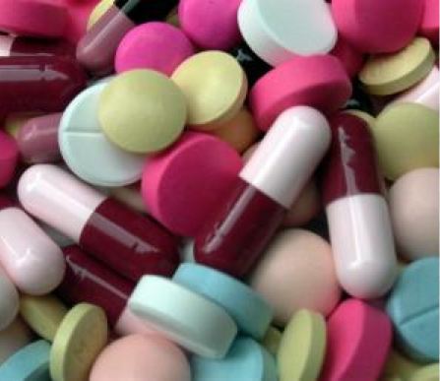
P&T: “What is it good for?”
Pharmacy & Therapeutics/ ID Subcommittee
Which drugs to add?
Providers can request
All new antimicrobials are reviewed within a year of FDA approval (usually within 6 months)
Unbiased review of clinical data
7

Slide 8
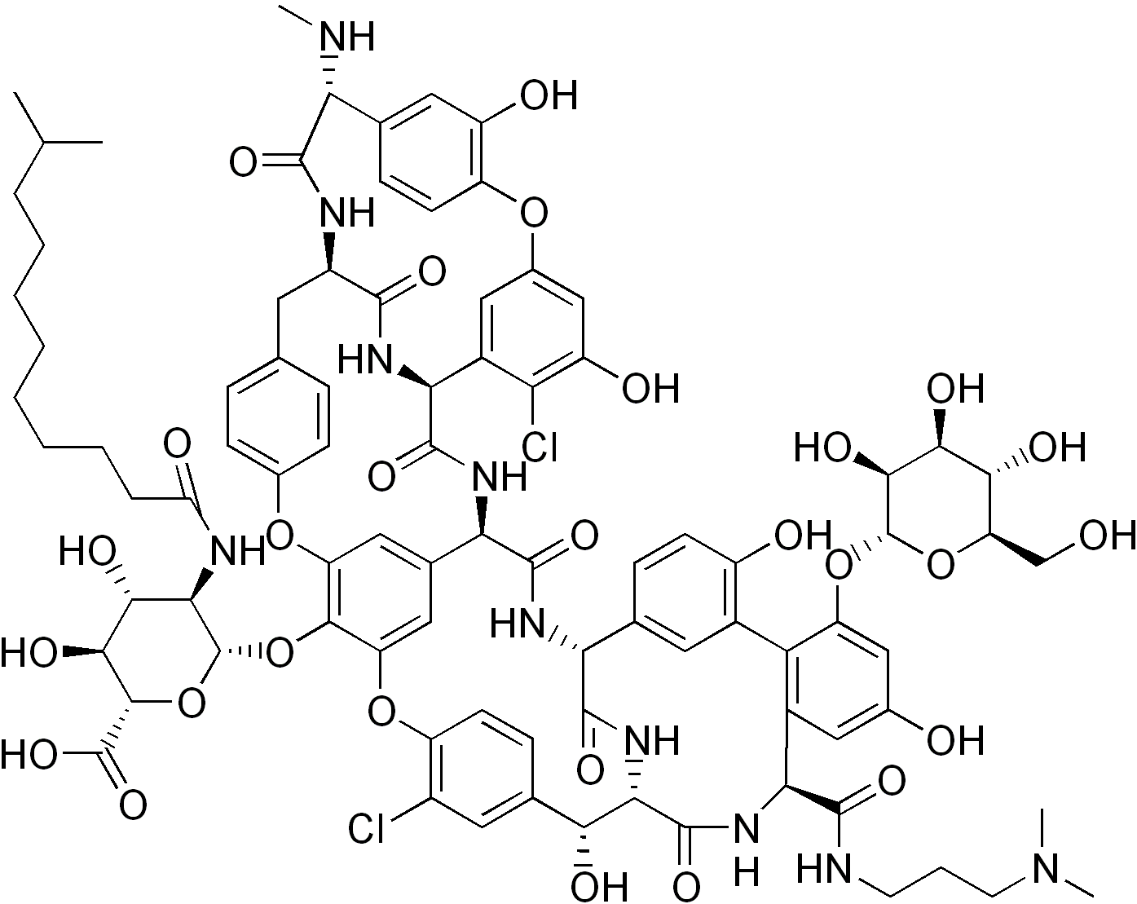
P&T: “What is it good for?”
Pharmacy & Therapeutics
Which drugs to add?
Example: Dalbavancin & Oritavancin
“Exciting” new class (lipoglycopeptides)
Concern for toxicity (allergic? too bad!)
Not approved for IE (where we need it)
Expensive (~$4,500 per injection)
8

Slide 9
REASSESS after 2 years, pull if abused
P&T: “What is it good for?”
Pharmacy & Therapeutics
Which drugs to add?
Example: Dalbavancin & Oritavancin
NOT add oritavancin
ADD dalbavancin RESTRICTED to ID approval
Catheter related bacteremia due to susceptible organism in which conventional intravenous antimicrobial therapy has failed or conventional intravenous therapy is not feasible due to circumstances of social history or adherence to treatment therapy.
Complicated skin and soft tissue infection with associated bacteremia in which conventional antimicrobial therapy is warranted but not feasible secondary to poor medication adherence
9

Slide 10
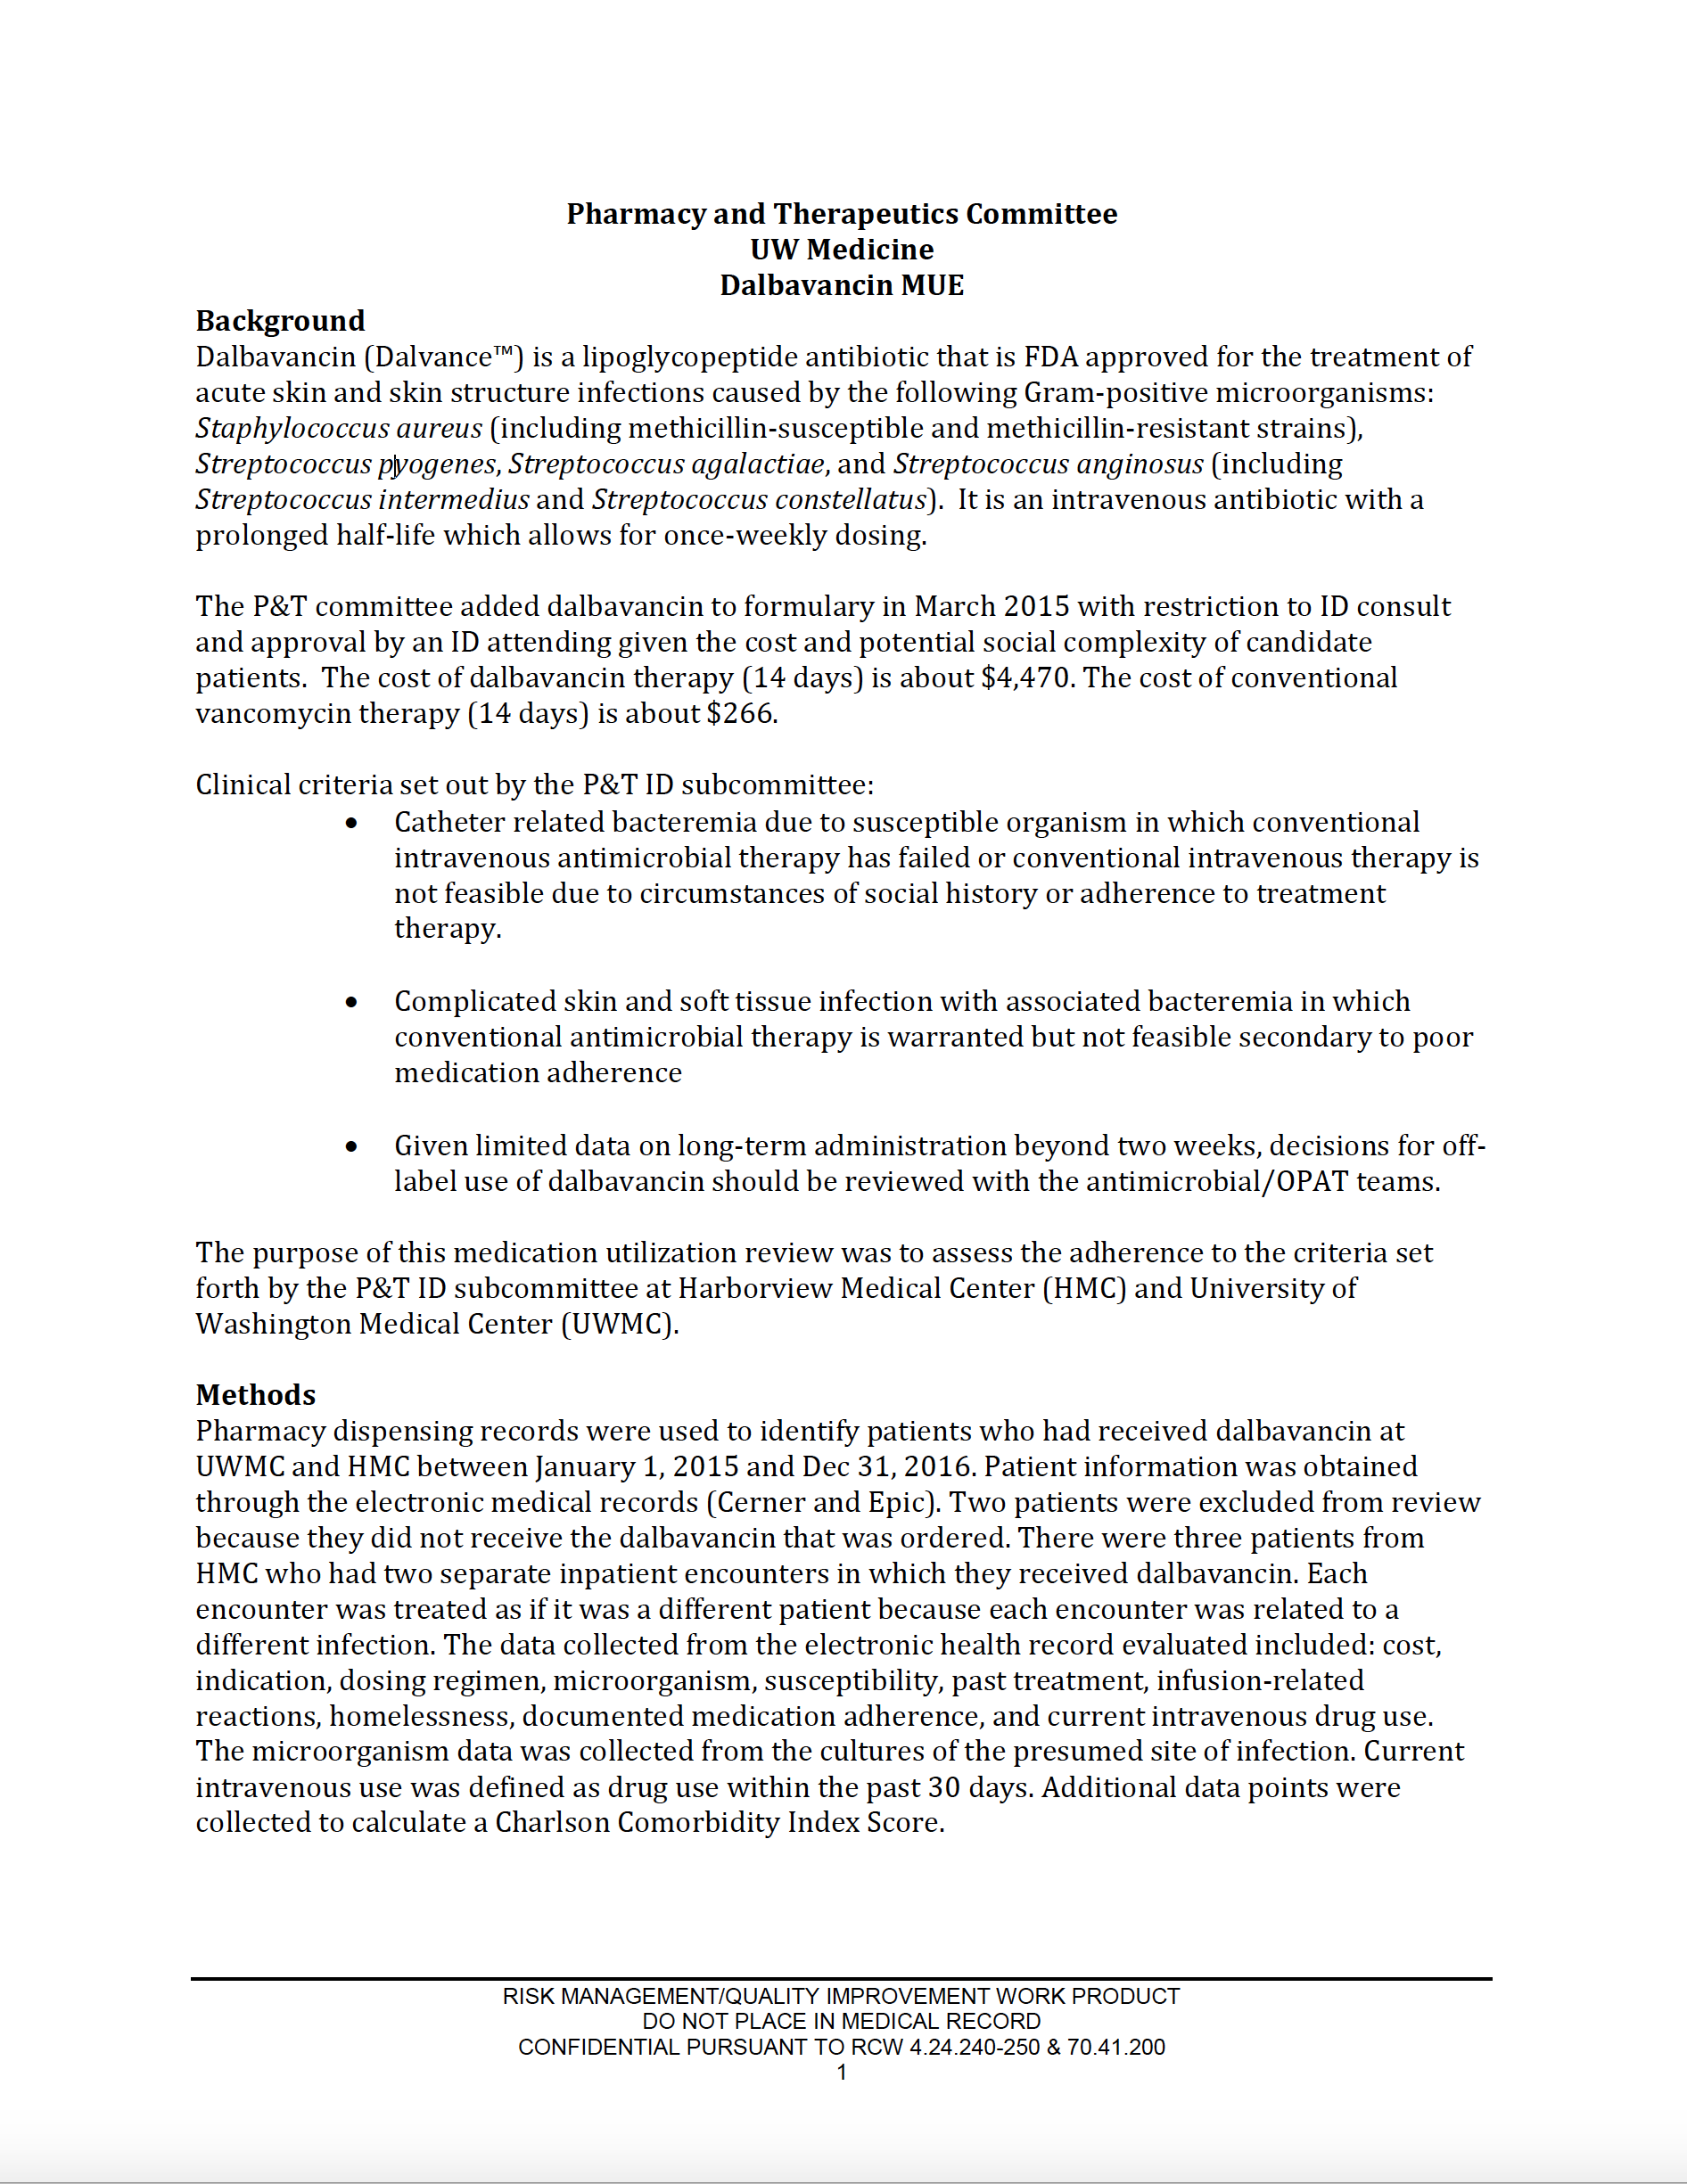
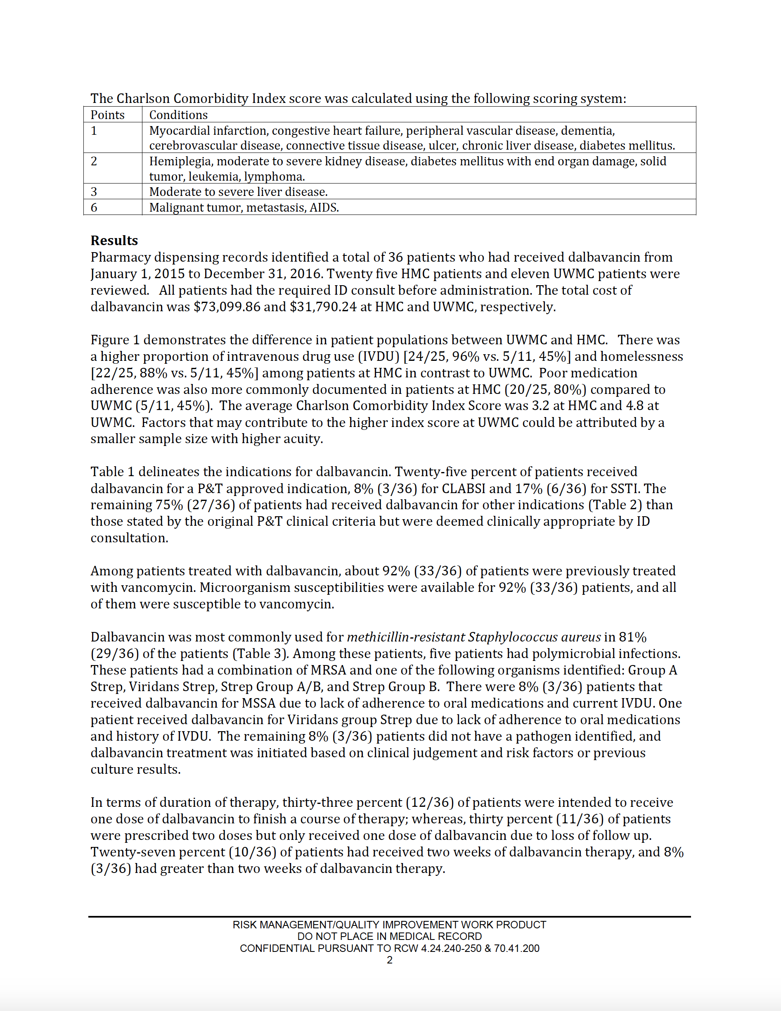
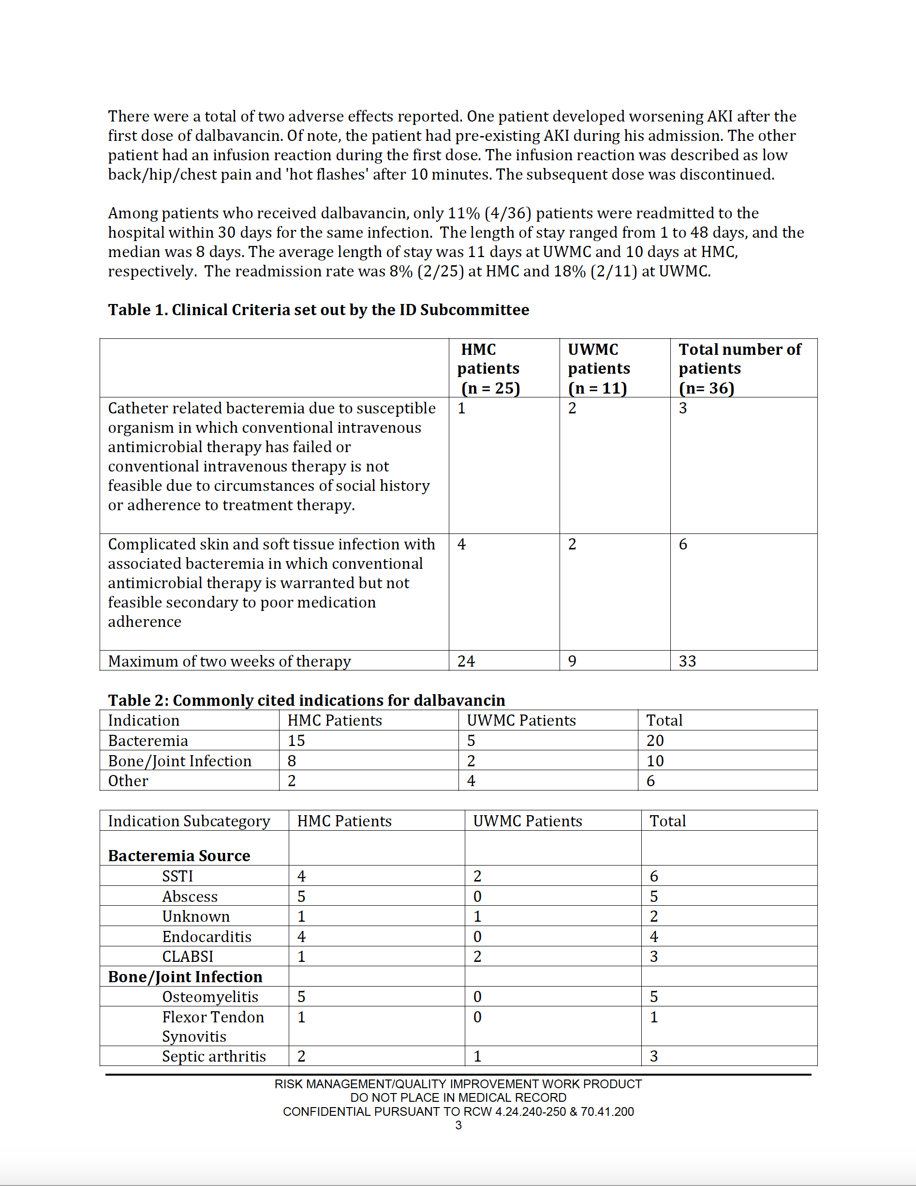
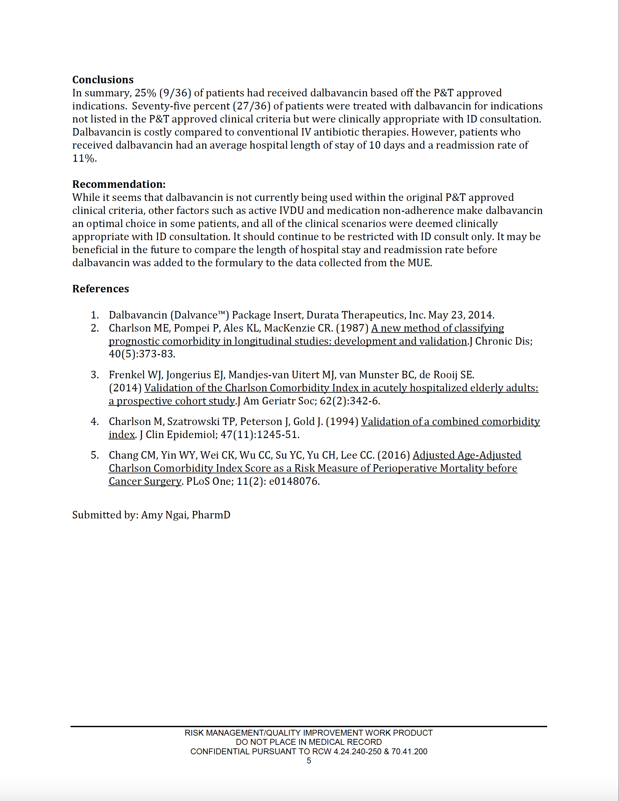
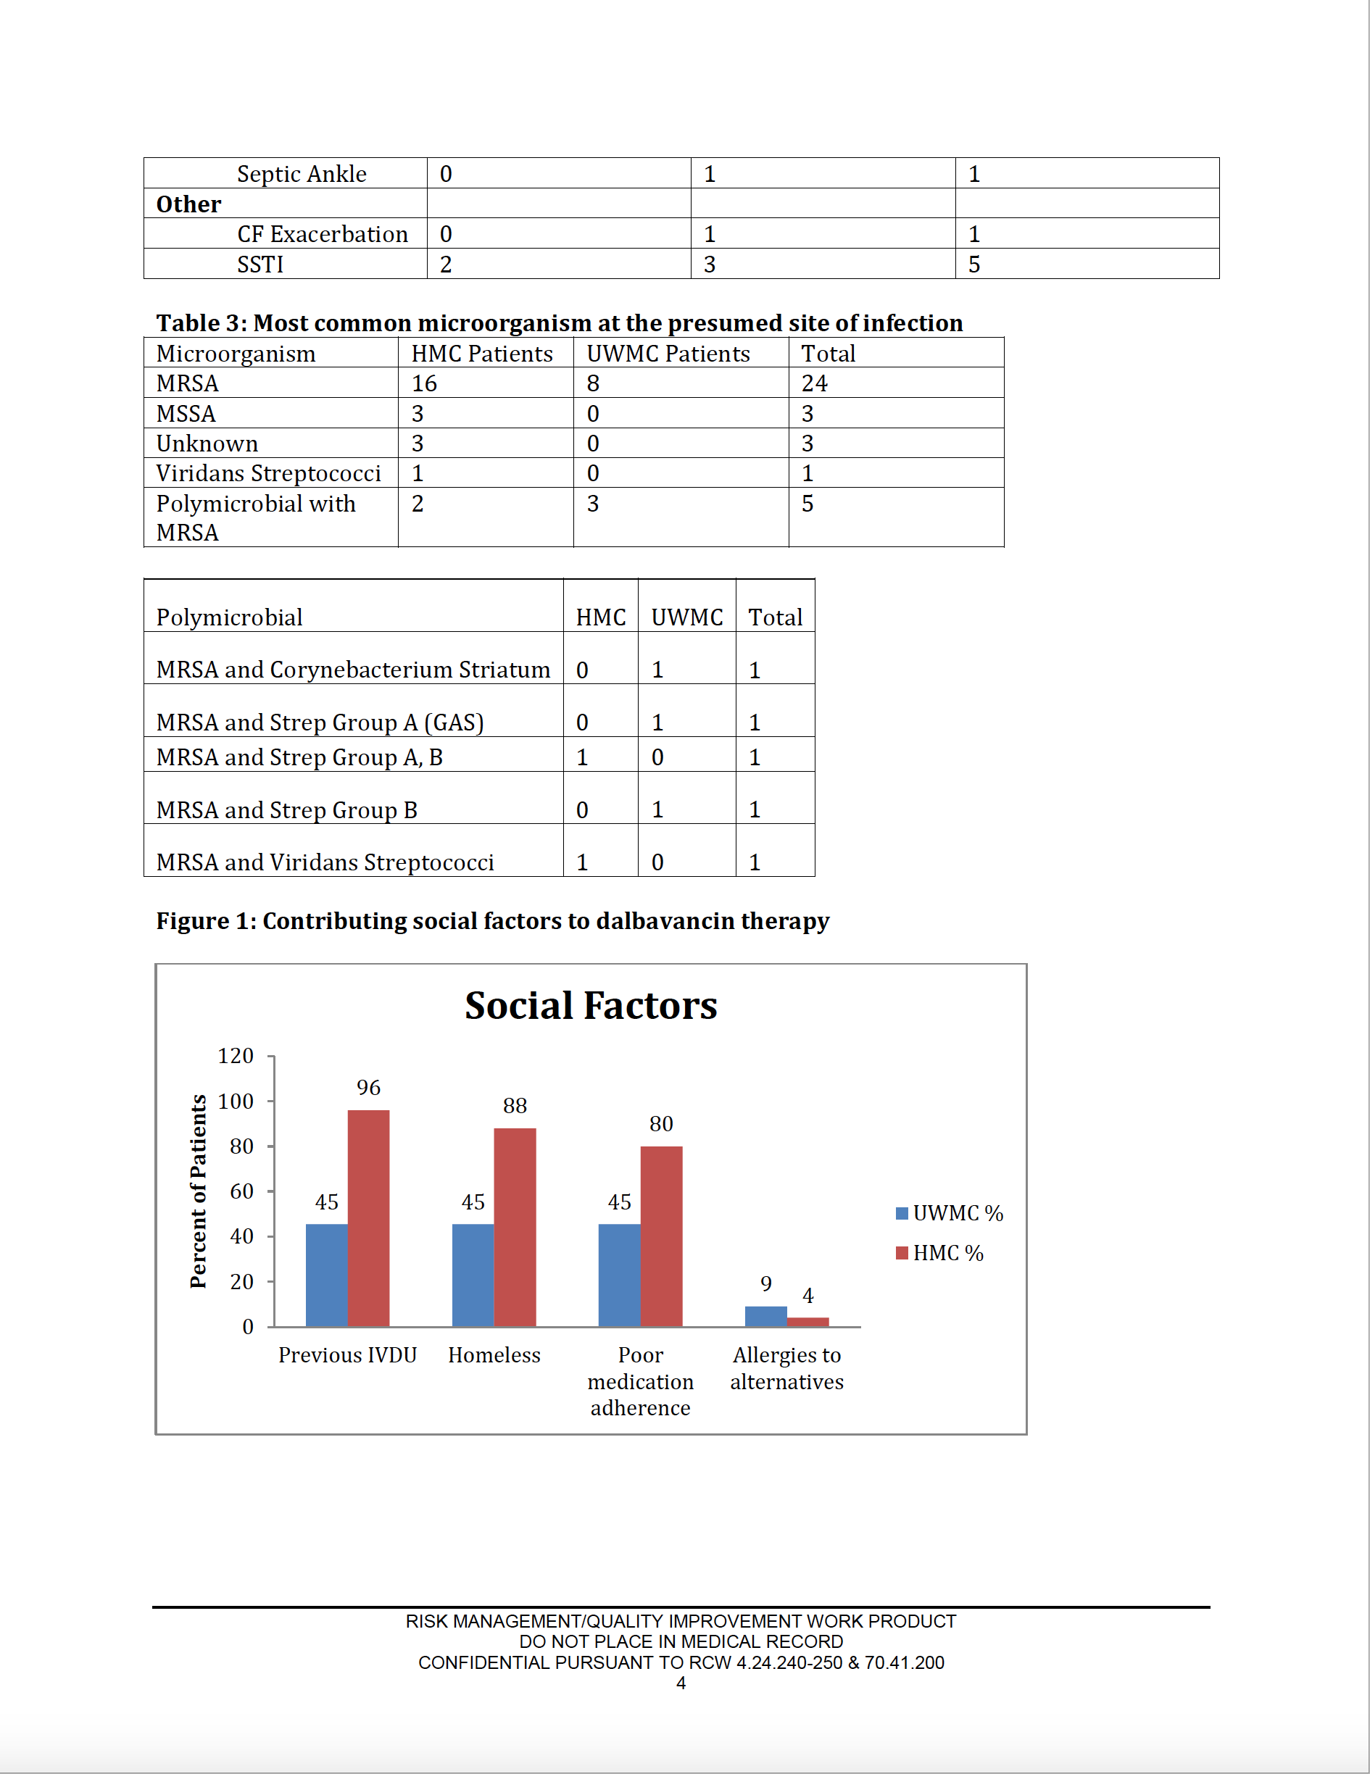
Used 36 times
$ 105,000
75% outside guidelines
ID always involved
12% readmission rate
Remains on formulary
P&T: “What is it good for?”
10

Slide 11
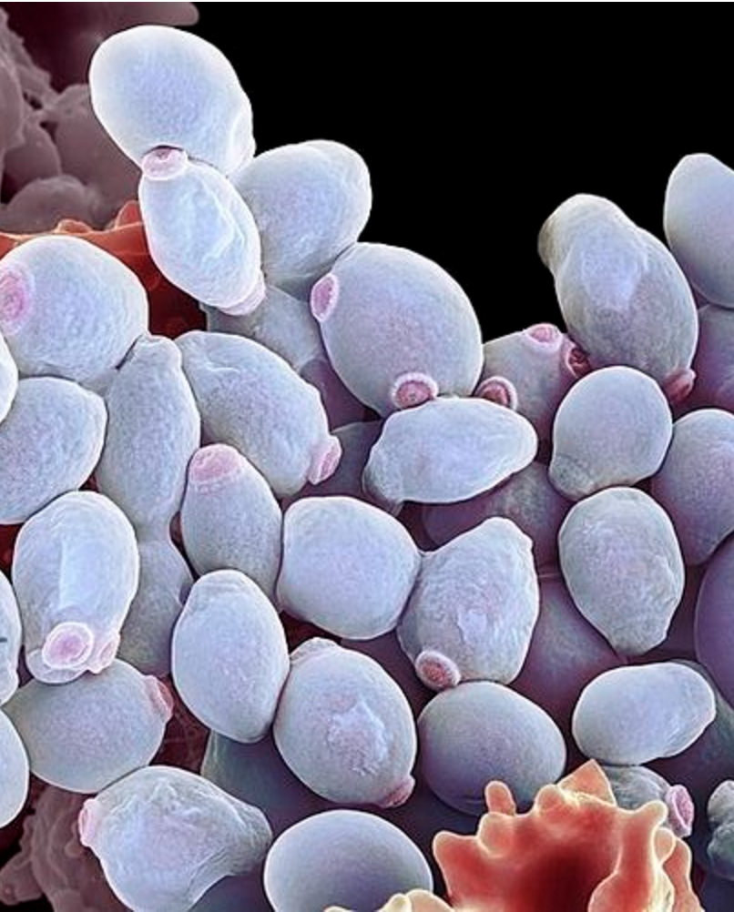
P&T: “What is it good for?”
Pharmacy & Therapeutics
Which drugs to remove?
Example: Caspofungin & Micafungin
Both excellent anti-candida drugs
Caspo had been on formulary for years
Mica has similar spectrum, interaction profile, dosing issues… but changing saved us $500K
No regrets or patient harm after the switch
11

Slide 12
Question…
How often does your P&T Committee review existing formulary?
Every Time
Annually
Other
I’m not sure
Paul Pottinger MD

Slide 13
P&T: “What is it good for?”
Additional Pharmacy & Therapeutics activities:
Adverse drug event monitoring
Medication-error prevention
Development of clinical care guidelines
Communication for drug shortages and interchanges
Resource for medication use evaluations (MUEs)
Newsletters
Supports rather than replaces antimicrobial stewardship
Guidelines on the Pharmacy and Therapeutics Committee and Formulary System; ASHP.
13

Slide 14
Conclusions
P&T: “Good for you… sometimes ugly”
Lowest Hanging Fruit on the Tree!
Availability drives use
Stakeholders at the table
Resist industry pressure to add the latest abx! (newer ≠ better)
Reviewing current formulary may save $
Shared resources can help
Paul Pottinger MD

