Slide 1
UW Medicine
COVID-19 Vaccine Training
HMC Employee Health
UWMC Employee Health
UW Neighborhood Clinics

Slide 2
COVID-19: The Basics
SARS-CoV-2 is the virus that causes COVID-19
SARS-CoV-2 is more infectious than the flu
Compared to the flu, SARS-CoV-2 is associated with a higher risk of death as well as severe illness among people who are unvaccinated
Some people with COVID-19 develop symptoms that last for a long time

Slide 3
COVID-19: The Basics
After exposure, it can take 2-14 days to become infectious
People with COVID-19 are infectious BEFORE they develop symptoms
Some people may be contagious even if they have no symptoms at all

Slide 4
Symptoms/Presentation
People with COVID-19 can have a wide variety of symptoms
There’s no way to know how it will present in a given patient until they get it.
Chronic/”long-haulers”
Acute/ICU-level care
Asymptomatic
Mild/flu-like
Fatal

Slide 5
When you are vaccinated, you protect…
Yourself
Your loved ones
Your community
Your patients

Slide 6
When you are vaccinated, you have a…
Much lower risk of catching COVID-19
Much lower risk of developing severe infection (regardless of variants)
Much lower chance of infecting others

Slide 7
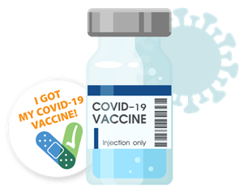
Let’s talk about COVID-19 vaccines

Slide 8
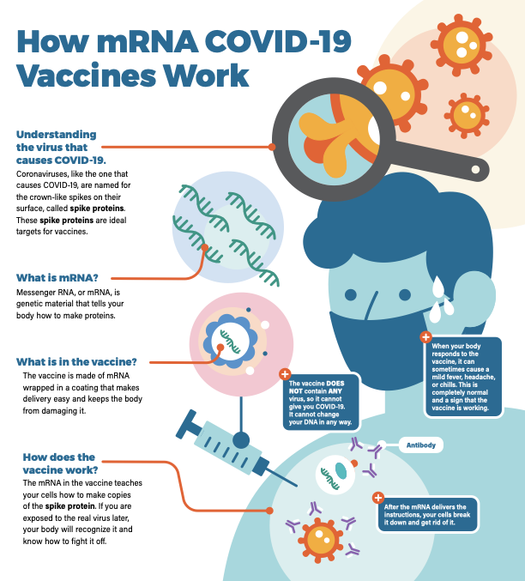
mRNA Vaccines
Pfizer & Moderna
2 doses
HIGHLY effective in preventing infection and protecting against severe infection

Slide 9
Do these vaccines cause an immune response?
Yes! This means your immune system is working
Sore arm, fatigue, sometimes fevers, body aches and other responses are common
In some cases they may interrupt your work for 1-2 days after vaccination

Slide 10
COVID-19 Vaccine Myth:
“The side effects are worse than getting COVID-19”
Most people with side effects experience short-term mild or moderate reactions that resolve completely
Side effects of COVID-19:
Isolation
Hospitalization
Long-term symptoms and disability
Infect other people
Death

Slide 11
Are these vaccines safe?
Scientists and companies accelerated vaccine development and production but did not skip any of the normal steps
Vaccine safety process was NOT done at warp speed
Same rigorous safety standards as all other vaccines
UW Medicine has vaccinated 100’s of thousands of patients and staff safely
100’s of millions of doses have been given SAFELY around the world

Slide 12
COVID-19 Vaccine Myth:
“The development of COVID-19 vaccines was rushed, which means they cut corners in the testing process.”
Here’s how:
Many trials were run at the same time, instead of one after another.
Paperwork was sped up
The researchers had a huge body of work to build upon; other coronavirus vaccines had been in development for years prior.
The studies were well funded.
In short, the researchers had the resources they needed to move fast.

Slide 13
What about long term effects?
There are no known long term side effects of mRNA vaccines
Long term, persistent symptoms due to COVID-19 are well described and can be disabling

Slide 14
Johnson & Johnson
Uses a viral vector, not mRNA based
Does NOT contain live or attenuated COVID-19 virus
1 dose!
Effective in preventing COVID-19 infection and HIGHLY effective in preventing hospitalization and death

Slide 15
COVID-19 Vaccine Myth:
“If I get vaccinated, I could spread COVID-19 to others.”
You cannot spread COVID-19 from the vaccine itself.

Slide 16
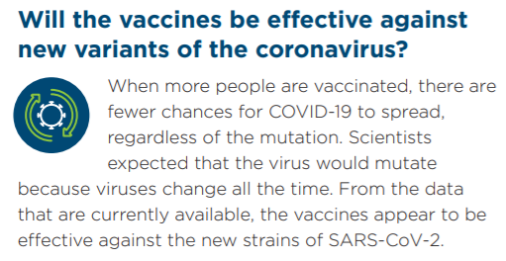
COVID-19 Vaccine Myth:
“They don’t work against variants, so what’s the point?”

Slide 17
COVID-19 Vaccine Myth:
“COVID-19 vaccination is not safe for me because I am pregnant, breastfeeding, or trying to get pregnant”
Pregnant people are at increased risk of death, severe illness, and adverse neonatal outcomes due to COVID-19
Current data is very reassuring; national surveillance systems have not identified safety concerns for pregnant people or their babies
There is evidence that when people receive the vaccine during pregnancy or while breastfeeding, they can protect their newborns
There is no vaccine known to cause infertility
If you have additional questions, please discuss with your OB-Gyn

Slide 18
The Bottom Line
Please consider making a difference by protecting yourself, your co-workers, your loved ones, and your vulnerable patients
The vaccines are safe, effective, and will get your life back to normal
COVID-19 vaccination is available to all UW Medicine staff, free of charge.

Slide 19
The Bottom Line (continued)
If you are not vaccinated and exposed to COVID-19, you will have work restrictions
Unvaccinated staff may have different requirements including PPE
If you develop COVID-19, UW Medicine performs contact tracing for all staff
We strongly believe in being honest with patients if they were put at risk

Slide 20
On behalf of our staff and patients, thank you for considering vaccination
Questions?
HMC Employee Health: ehshmc@uw.edu
UWMC – NW Employee Health: employeehealthNW@uw.edu
UWMC – ML: emhealth@uw.edu
UW Neighborhood Clinics: uwnc-employee-health@uw.edu

Slide 21
The Declination Process
If you still choose to decline vaccination after completing this training, you will be asked to answer a series of questions on what you have just learned.
In order to receive credit for this course, you must successfully pass the quiz with a score of 100%.
If your declination is on medical grounds, please provide medical documentation to Employee Health along with your declination forms.

